Slide 1
ATTENTION DEFICIT DISORDERS

Slide 2
No greater blessing in the life of a child with ADHD than adults who understand ADHD.

Slide 3
The Disorder(s)

Slide 4
What is ADHD?

Slide 5
What is ADHD/ADD?
Common disorder (3-6%) Crosscultural
Neurobiological, not “psychological”
Extensively researched with broad agreement on fundamentals

Slide 6
What is ADHD/ADD?
Treatable, but potentially serious chronic disorder
As a rule, without treatment, ADHD contributes to lots of problems, extending into adulthood

Slide 7
What is ADHD/ADD?
Problems with
Focus & attention
Impulse control / hyperactivity (in most cases)
Emotional regulation
Other associated problems

Slide 8
What is ADHD/ADD?
Problems with
Focus & attention
Impulse control / hyperactivity (in most cases)
Emotional regulation
Other associated problems

Slide 9
Three types (DSM)
ADHD, Predominantly Inattentive
ADHD, Predominantly Hyperactive-Impulsive
ADHD, Combined
Inattention symptoms
Hyperactivity Symptoms

Slide 10
ADHD, Combined Type
Has both sets (Inattention AND Hyperactivity/Impulsivity.
Probably most common type & certainly most commonly diagnosed.

Slide 11
ADHD/ADD: Developmental
Diagnosis: Always have to compare child to peers.
Starts in early childhood. Most do NOT “grow out of it.”
Persists into adulthood but may become less disabling, especially with treatment.

Slide 12
ADHD/ADD: Developmental
In general, ADHD youth lag behind developmentally. Think 2-3 years.

Slide 13
“Growing out” of ADHD
New analysis of data (Roy, et al. J. of American Acad. of Child & Adolescent Psychiatry, Nov 2016, Vol 55, # 11)
450 subjects, average age 25, diagnosed with ADHD as children.
About 50% no longer had significant impairment. 50% did.

Slide 14
“Growing out” of ADHD
Group that DID have significant impairment in their 20’s.
More severe symptoms when diagnosed
More co-occurring disorders
More mental health problems in their parents
Problem with data: We don’t know what kind of treatment they got (or didn’t get.)

Slide 15
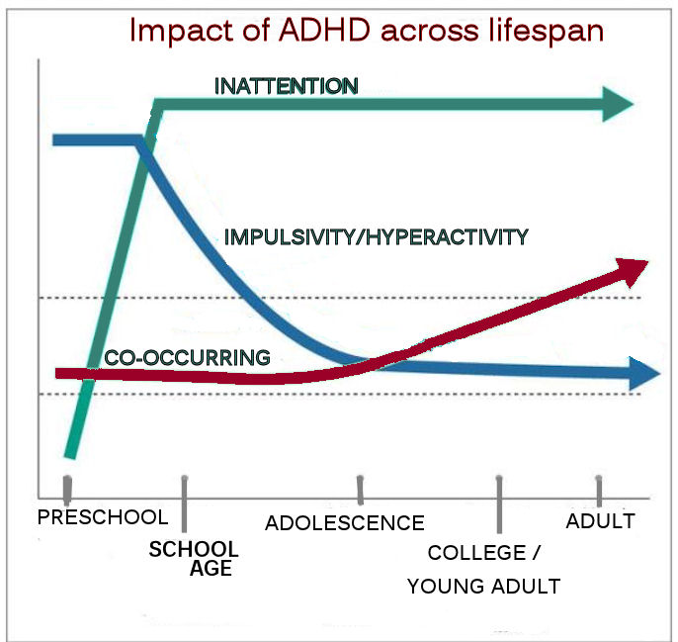

Slide 16
ADHD: The Core Deficits
ATTENTION
BEHAVIORAL INHIBITION (IMPULSIVITY / HYPERACTIVITY)
EMOTIONAL REGULATION

Slide 17
ADHD: The Core Deficits
ATTENTION
BEHAVIORAL INHIBITION (IMPULSIVITY / HYPERACTIVITY)
EMOTIONAL REGULATION

Slide 18
What is ADHD?
Disorder of age-inappropriate behavior in 2 (or 3) neuro-behavioral areas:
Inattention
Poor persistence toward goals or tasks
Distractible
Trouble re-engaging after distraction
Impaired working memory

Slide 19
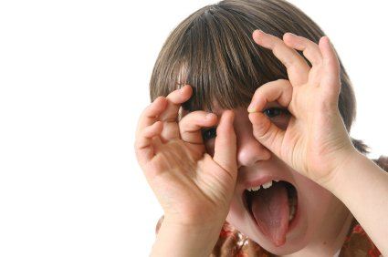
(notes about paying attention)
Attention span is often fine in activities child finds interesting & fun.
Q: Can child pay attention to not-so-interesting & fun stuff?
Good days/bad days.

Slide 20
ADHD: The Core Deficits
ATTENTION
BEHAVIORAL INHIBITION (IMPULSIVITY / HYPERACTIVITY)
EMOTIONAL REGULATION

Slide 21
Civilization requires that most people, most of the time, inhibit their impulses. No one can function without this ability. That ability is (often) RELATIVELY lacking in ADHD.

Slide 22
Hyperactivity-Impulsivity (Inhibition)
Impaired verbal & motor inhibition
Impulsive: cannot wait or defer gratification
Decreased valuing of future consequences over immediate ones
Excessive task-irrelevant movement/verbal behavior
Fidgeting, squirming, running, climbing

Slide 23
ADHD: The Core Deficits
ATTENTION
BEHAVIORAL INHIBITION (IMPULSIVITY / HYPERACTIVITY)
EMOTIONAL REGULATION

Slide 24
EMOTIONAL DYSREGULATION in ADHD
Emotionally impulsive
Poor inhibition of inappropriate emotional behavior
Low frustration tolerance, impatient

Slide 25
EMOTIONAL DYSREGULATION in ADHD
Quick anger/hostility
Emotional excitability, reactivity, raw expression
Difficulties offsetting negative emotion with positive
Impaired self-motivation

Slide 26
The question of motivation. What is lazy?

Slide 27
ADHD: The Core Deficits
ATTENTION
BEHAVIORAL INHIBITION (IMPULSIVITY / HYPERACTIVITY)
EMOTIONAL REGULATION

Slide 29
“ADD WITHOUT HYPERACTIVITY” ADHD, Predominately Inattentive Type

Slide 30
“ADD WITHOUT HYPERACTIVITY”
ADHD but without the H.?– Probably not
ADHD & “ADD” may be too dissimilar to be same disorder
Not nearly as well researched or understood
Confused terminology: “ADD,” “Just ADD,” “ADHD WITHOUT HYPERACTIVITY,” “ADHD, PRIMARILY INATTENTIVE TYPE

Slide 31
“Sluggish Cognitive Tempo”
Described in the literature since 1980s.
“Concentration Deficit Disorder.”

Slide 32
SCT
“Characterized by … daydreaming, sleepy, staring, “spaciness,” mental fogginess/confusion and slow movement, hypoactivity, lethargy, passivity.”—Russell Barkley
It is a topic of research, not an official diagnosis.

Slide 33
“ADD”
Associated with significant impairment, social & academic, & for adults, occupational problems.
Risk for anxiety & depression
Cause: Genetics, fetal alcohol exposure, treatment of acute lymphoblastic leukemia
Treatment: Little research. Stimulant use common.

Slide 34
ADD
Shy, reticent, withdrawn
Daydreamy, sluggish
No impulsivity (motor or verbal) or behavior problems
Poorly organized
Passive in school

Slide 35
ADD
Rarely aggressive or ODD/CD
More prone to anxiety & depression
Parents generally less stressed (so may be less motivated to treat)
Parents more concerned about academics
Symptoms may actually increase slightly with age
Later age of diagnosis typical
Gender: ADHD, COMBINED Boys>Girls (2+:1); ADHD, PIT: Boys only slightly more than girls, if that.

Slide 36
Treatment implications
Less likely to respond as robustly to stimulant medications (but still treatment of choice.)
Better response to social skills training than in classic ADHD cases
Treatment of anxiety or related OCD often needed.

Slide 37
Back now to ADHD in general…

Slide 38
ADHD: More common features
2-3 year delay in overall maturity common.
Prone to other conditions (2 out of 3): Depression, anxiety, and especially learning disabilities.
Problems with sense of time.
Academic problems common.
Impulsivity a major source of problems & complications.

Slide 39
Causes?
Neurobiological basis
Precise nature unknown
(FDA has allowed marketing of a diagnostic system based on EEG. Calculates ratio of brain wave frequencies.)
Strong genetic connection
Genetic contribution to ADHD is almost as strong as the genetic contribution to height.
Sometimes related to nervous system damage
Birth, accidents, severe illnesses

Slide 40
ADHD: The Core Deficits
ATTENTION
BEHAVIORAL INHIBITION (IMPULSIVITY / HYPERACTIVITY)
EMOTIONAL REGULATION

Slide 41
Adult Complications of untreated ADHD
School underachievement/failure
Depression, self-harm, suicide
Poor relationships, including marriages (divorces)
Substance abuse
Job problems

Slide 42
Adult Complications of untreated ADHD
Financial problems (Lower SES, underemployment & financial mismanagement)
Incarcerations
Unplanned pregnancies
ACCIDENTS (driving, head injury)

Slide 43
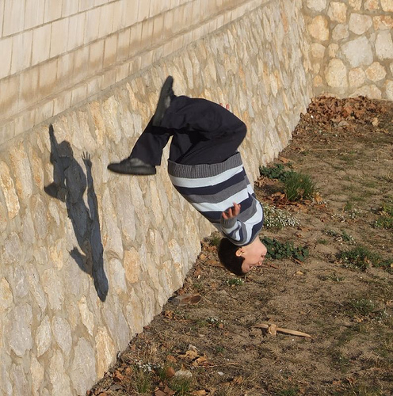

Slide 44
Impulsivity: A critical factor
3 types?
Motor
Drives hyperactivity; accident risk; social difficulties; high-risk behavior
Verbal
Social difficulties, problems in classroom.
Emotional

Slide 45
ADHD (NOT the medication) creates added risk of substance abuse
2011 analysis of 30 studies.
Children with ADHD at risk for developing
Alcohol use disorder by early adulthood (but not a HUGE added risk)
Tobacco use by middle adolescence (considerably higher risk)
Risk for other substance abuse problems not as clear

Slide 46
ADHD and Executive Functioning
Working memory
Time management
Regulation of emotions
Planning
Forethought
Learning from consequences
Organization

Slide 47
Common co-occurring disorders
Perhaps as many as 70% of people with ADHD will qualify for another diagnosis at some point.

Slide 48
Lifetime Prevalence in Pediatric Population with ADHD (Biederman, 2004)

Slide 49
ADHD & Girls: New Study (UCLA, PEDIATRICS, Oct 2016) 2000 girls between 8-13
Co-occurring disorders | ADHD GIRLS | Non-ADHD GIRLS
Anxiety Disorder | 38% | 14%
Depression | 10% | 3%
Oppositional/ Defiant | 42% | 5%
Conduct Disorder | 13% | <1%
Girls with attention deficit hyperactivity disorder are at higher risk than girls without ADHD for multiple mental disorders that often lead to cascading problems such as abusive relationships, teenage pregnancies, poor grades and drug abuse.

Slide 50
ADHD is NOT merely a person who has trouble paying attention, who may or may not be hyperactive.

Slide 51
An example of ADHD complexity
ADHD patients require more dental care. Why?

Slide 52
An example of ADHD complexity
ADHD patients require more dental care. Why?
Impulsivity = accidents = dental trauma
Poor hygiene
Grinding teeth
Genetics: thinner enamel?
Genetics: less resistance to oral bacteria

Slide 53
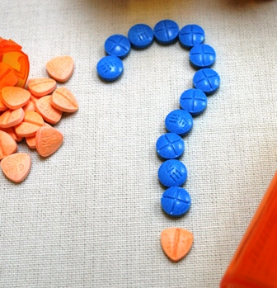
Controversies
Is it overdiagnosed?
Is medication overused?
Does it work over the long-term?
Do stimulant meds have a long-term downside?
Do “alternative” treatments work?

Slide 54
Overdiagnosis
A hypothetical cluster of human mental abilities:
Ability to focus attention appropriately
Ability to control one’s impulses
Ability to plan and organize
Etc.

Slide 55
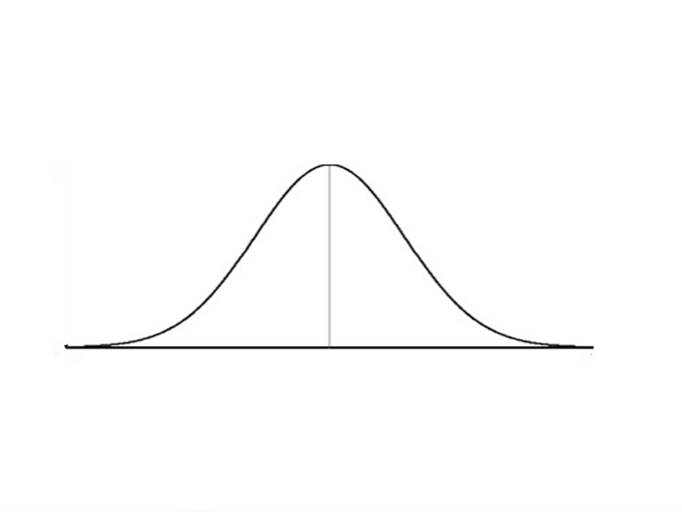

Slide 58
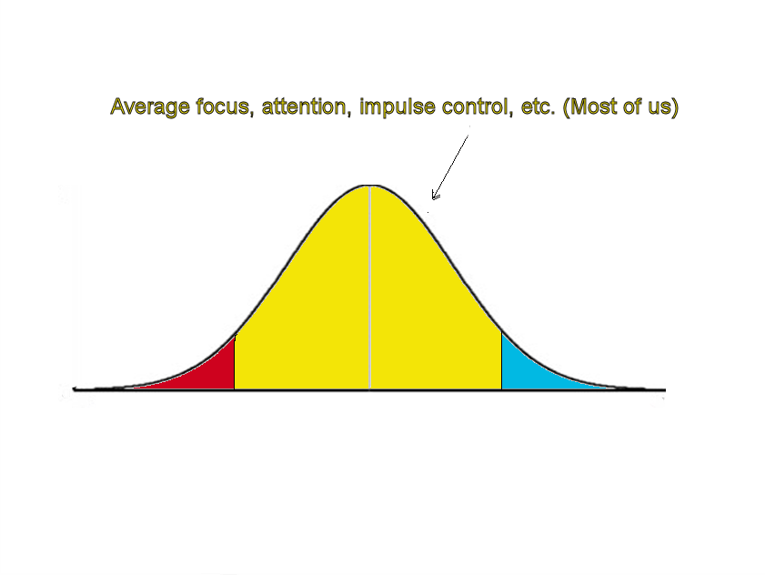

Slide 59
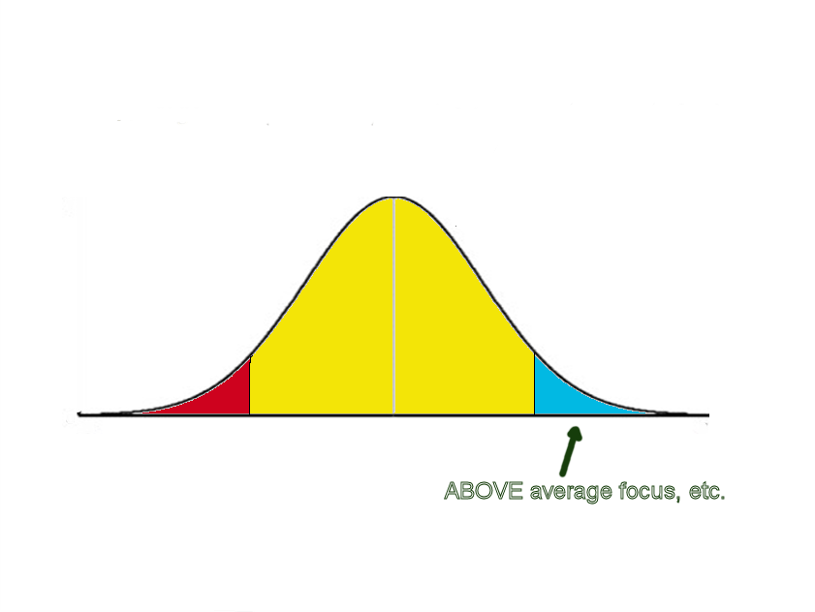

Slide 60
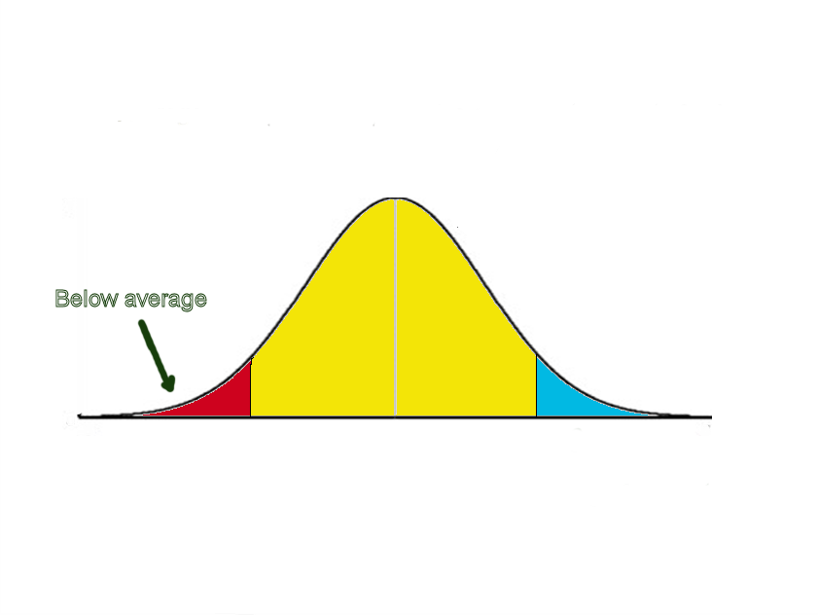

Slide 61
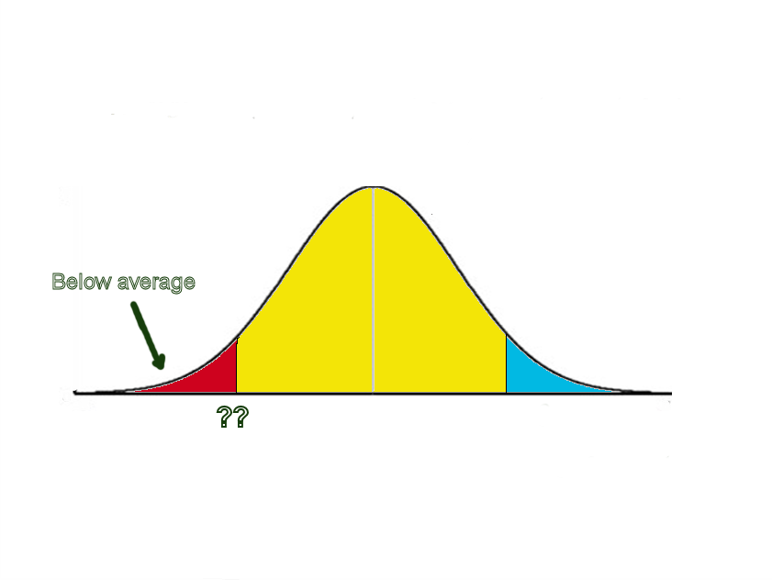

Slide 62
Overtreatment/Medication controversy
Based largely on myths and lack of knowledge.
The meds are largely safe and largely effective and are the most researched medications on the planet.
Accumulating research that most significant downside of stimulant medications: risk of height reduction of about 1 to 1.5 inches

Slide 63
A common misunderstanding about diagnosis and treatment
“I don’t think Jason has it because ADHD is being overdiagnosed. I don’t think Jason should take medicine because these medicines are being overprescribed.”
EVEN IF OVERDIAGNOSIS AND OVERTREATMENT IS A PROBLEM, IT DOESN’T FOLLOW THAT JASON DOESN’T HAVE THE DISORDER OR NEED THE TREATMENT.

Slide 64
Treatment

Slide 65
Benefits vs. risks of medication or Risks of medication vs. risks of not treating ADHD with medication

Slide 66
Life of the child with ADHD
Often inadequate medication treatment.
Tendency to start with low doses (okay?) but then to stay too low
Try 2, then quit
Poor persistence of treatment, even when it works
Behavioral treatments helpful, but require large “doses” and so rarely done adequately.
Most adults in child’s life don’t understand the disorder. Myths and misunderstandings abound.

Slide 67
The MTA ADHD study
Study suggests that benefits of ADHD medication diminish over time, but not clear why.
Study also suggests risk of reduced adult height increases of time & with more stimulant medication.

Slide 68
Treatment
Adult Education
Medication
Professional care/monitoring
Management at school
Management at home

Slide 69
ADHD: Medication categories
Stimulants (short-acting/long-acting)
Non-Stimulants specifically for ADHD (Strattera)
Non-Stimulants, devised and used for other disorders, but also used for ADHD
Complete, updated listings
http://www.adhdmedicationguide.com/

Slide 70
Stimulants
Most common
Short acting vs. Long acting
Could say short, medium, long
In and out
Side effects
Addiction?

Slide 71
Stimulant controversies
Does stimulant treatment of ADHD lead to substance abuse?
No. Accumulating evidence ADHD puts people at risk for substance abuse.
Metastudy published in 2003 suggested stimulant Rx reduced subsequent risk of substance abuse.
More recent and larger metastudy (2013) found no link between stimulant treatment & subsequent risk of substance abuse.
ADHD is associated with increased risk of substance abuse. Use of meds does not contribute to that risk. Whether use of ADHD meds REDUCES risk of subsequent substance abuse is unclear.

Slide 72
Growth suppression
Over time, research suggests that stimulant medications do carry risk of reduction of adult height.
With longer use and higher doses, more reduction of adult height. As much as 1.5 inches.
In short-run, benefits of ADHD meds likely outweigh this risk. In long-run, more questionable because research generally suggests that effectiveness of meds decline after the first 3 years.
Lots of confusing and contradictory information.

Slide 73
Strattera (atomoxetine HCl)
Non-stimulant
2-4 weeks to get going & stays in system
Some (low) risks of allergic reaction, heart problems, liver disease.
When it works, it works.

Slide 74
Alternative Therapies
Uncle Dale’s rule of Some:
Some studies show some ADHD people may get some better on some alternative treatments.
No alternative treatments work as well as medication.
Rarely will an alternative treatment be adequate alone (without medication).
Look for research basis, not individual success stories.
Consider the cost/benefit.

Slide 75
Alternative treatments with inadequate or no scientific support
Diet supplements*
Herbal supplements
Multivitamins
Restricted (elimination) diets (some modest success with extremely strict & limited diets)
Food dyes-modest effects on small number of people
Homeopathy
Chiropractic treatment
EEG biofeedback (neurofeedback)
Visual exercises
Psychotherapy to get at the “root of the problem”

Slide 76
CBD Oil & ADHD
1 controlled study to date:
small sample study of 30 people with ADHD who received a trial cannabinoid/CBD medication.
Insignificant improvement on cognitive function & symptom reduction, & nominal improvement on impulsivity and hyperactivity.
Researchers expressed concern that participants did not follow instructions to avoid all other medications or alcohol use that could have affected study results. Research authors stated that their results were inconclusive.

Slide 77
CBD Oil & ADHD
“When parents or adults look into CBD oil for someone with ADHD, it’s not just that there’s a lack of evidence out there right now. There’s been no treatment studies. There’s no randomized trials that show it works. And there’s other treatment options available for kids and adults with ADHD. These are unregulated products.”
(What about the question of CBD oil being a more natural option than a medication? It comes from a plant, after all.)
“Natural doesn’t necessary means it’s less harmful.”
-John T. Mitchell PhD

Slide 78
Alternative treatments with best evidence of helpfulness
EXERCISE/MOVEMENT (strong evidence)
Increased OMEGA FATTY ACIDS (moderate but conflicting evidence)

Slide 79
Alternative treatments with best evidence of helpfulness
EXERCISE/MOVEMENT (strong evidence)
Doesn’t matter what kind of exercise.
Being outside (“Green Therapy”)
Martial Arts often a good choice.

Slide 80
Diet
Some studies suggest some patients do some better on very strict elimination diets
Three European studies indicates good results from a “strictly supervised” “few-foods” elimination diet.
Typical diet:
Rice, turkey, lamb, vegetables, fruits, margarine, vegetable oil, tea, pear juice.
No red meat, fish, dairy, pasta, bread, sugar, artificial additives, etc.

Slide 81
Diet
A minority of individual children may respond to smaller and more specific dietary changes.
There is some support for reducing artificial dyes and sodium benzoate.
Science and I say you can’t fix ADHD with diet.

Slide 82
Diet
We would ALL do well to eat a wholesome, organic diet. Just not clear how much more ADHD patients would benefit from benefit we would ALL get.
Look for signs of reactions to food additives. Try reducing those. Balance the benefit against the stress it causes you and your child.

Slide 83
Omega-3 Fatty Acids
“Small, but significant” overall effect.
Higher doses of particular Omega-3, eicosapentaenoic acid (EPA) most effective.
Authors recommended against substituting these for ADHD meds.
Consult doctor.
Bloch and Qawasmi (2011) reviewed the literature & performed meta-analysis of studies to date.
699 subjects in various studies, all children & youth.
J. of American Academy of Child & Adolescent Psychiatry

Slide 84
Rx: Vayarin

Slide 85
EQUAZEN, another brand-name fish oil/primrose oil product

Slide 87
ADHD Medications
… are relatively safe and relatively effective.
… there are no absolutely safe and absolutely effective medications.

Slide 88
Treatment
Adult Education
Medication
Professional care/monitoring
Management at school
Management at home

Slide 89
Teaching

Slide 90
The ideal educational program
Education about ADHD to student, parents, and educators
Better understanding of strengths, weaknesses, impairments
Reasonable goals, with balanced life in mind, monitored and revised
Skills to address executive function deficits

Slide 91
Just know…
Number of students with disorders and disabilities we serve has expanded rapidly.
Range of measures we are expected to take for each child has expanded.
Resources, and funding, have not expanded.

Slide 92
The curse: Almost no one the student encounters truly understands the disorder.

Slide 93
A key question
ADHD is a DELAY in development of key neuropsychological domains. NOT related to IQ or intelligence.
Rough guide: 1/3 of age
AGE | 6 | 9 | 12 | 15 | 18
ADJUSTED AGE | 4 | 6 | 8 | 10 | 12

Slide 94
A key question
Would I give this task to a ____-year-old give the amount of support I have provided?
If no, what support would be in place for a ____-year-old to complete the task?
AGE | 6 | 9 | 12 | 15 | 18
ADJUSTED AGE | 4 | 6 | 8 | 10 | 12

Slide 95
Point of Performance reminders
Creative, supportive, non-judgmental, non-embarrassing PROMPTS or REMINDERS to perform a task, remember a task, transition from one task to another
Verbal, nonverbal, written

Slide 96
Self-monitoring aides
Notes
Checklists
Calendars !!
REMEMBER: DEFICITS IN WORKING MEMORY

Slide 97
Training self-speech is training self-monitoring
FEELINGS
THOUGHTS (SELF-SPEECH)
BEHAVIOR

Slide 98
BREATHING
TALKING TO SELF

Slide 99
Homework
Reduce as much as you are able and willing, provide more time WITH PROMPTS and support.

Slide 100
Sandra F. Reif, How to Reach and Teach Children ADD/ADHD (3nd Ed.)
Jossey-Bass Teacher, 2016

Slide 101
Critical Factors in Success (Reif)
1. Belief in the Student—Doing What It Takes
2. Clarity and Structure
3. Close Communication Between Home and School
4. Collaboration and Teamwork

Slide 102
Critical Factors in Success (Reif)
5. Creative, Engaging, and Interactive Teaching Strategies
6. Developing and Bringing Out Student’s Strengths
7. Effective Classroom Management and Positive Discipline
8. Environmental Modifications and Accommodations

Slide 103
Critical Factors in Success (Reif)
9. Flexibility and Willingness of Teacher to Accommodate
10. Help and Training in Organization and Study Skills
11. Knowledge and Understanding of ADHD
12. Limit the Amount of Homework

Slide 104
Critical Factors in Success (Reif)
13. Modifying Assignments and Written Workload
14. More Time, More Space
15. Support of Administration
16. Valuing and Respecting Learning Styles/Differences, Privacy, Confidentiality, Student Feelings

Slide 105
The purpose of Mountain Brook Schools is to provide an effective, challenging, and engaging education for every one of our students.

Slide 106
Accommodations

Slide 107
Seating
Away from windows / door.
In front of your desk unless that would be a distraction for the student.
Watch for sources of distraction and move away.
Sensory deprivation does not work!

Slide 108
Delivery
Instructions one at a time / repeat as necessary. Break down multi-part instructions.
Mornings tend to be better.
Use visuals: charts, pictures, color coding.
Assist with note-taking.

Slide 109
Student Work
Quiet area to work.
Shorter packets of work. Divide long-term projects into segments / assign a completion goal for each segment.
Reduce the number of timed tests/consider extra time.

Slide 110
Student work
Consider testing orally or filling in blanks.
Show how to use a pointer or bookmark to track written words on a page.
Let do as much work as possible on computer.
Accept late work / give partial credit.

Slide 111
Organization
Make sure the student with ADD/ADHD has a system for writing down assignments and important dates and uses it.
Master notebook, a three-ring binder with a separate section for each subject, and make sure everything that goes into the notebook has holes punched and is put on the rings in the correct section.
Provide a three-pocket notebook insert for homework assignments, completed homework, and “mail” to parents (permission slips, PTA flyers).
Color-code materials for each subject.
Allow time for student to organize materials and assignments for home. Post steps for getting ready to go home.

Slide 112
Time management
Think of ADHD students as “time-blind”
Not (necessarily) procrastinators

Slide 113
Tips on behavioral intervention
“The more you call them out in class, the less they hear.”
Behavioral interventions as private as possible. Use nonverbal signals.
Keep a disability perspective.

Slide 114
Books
Russell Barkley: Your Defiant Children and Your Defiant Teen
Rex Forehand: Parenting the Strong-Willed Child
Carolyn Webster-Stratton: The Incredible Years.
Thomas Phelan: 1-2-3 Magic.
Chris Zendy: Teenagers with ADD.

Slide 115
Parenting

Slide 117
The ADHD family
ADHD, among other things, is about trouble with focus & attention, impulsivity and hyperactivity, and poor regulation of emotions.
ADHD is very often hereditary, meaning an excellent chance at least one parent may have it, maybe a sibling or two.

Slide 118
ADHD FEATURE | Family impact
Inattention/Focus | Pay attention! How many times have I told you? You never mind me! You’re so smart, what’s with these grades?!
Hyperactivity/Impulsivity | How could you have done that?! What were you thinking?!
Emotional Dysregulation | Calm down! (No, YOU calm down!) Lots of frustration, conflict, shouting, fussing-at.
Hereditary nature | Parent with ADHD has trouble following through and being consistent, and has trouble controlling emotional reactions to child’s behavior.

Slide 119
Parenting
No shortcuts or easy answers.
It can be hard.
Keeping disability perspective.

Slide 120
Russell Barkley’s Principles (modified)
Give child more feedback & consequences, more frequently.
Use larger and more powerful consequences.
Use incentives before punishment.
Help with keeping up with time.

Slide 121
Russell Barkley’s Principles (modified)
Strive for consistency.
Act, don’t yak.
Plan ahead for problem situations.
Don’t personalize your child’s problems.
Practice forgiveness.
Take care of yourselves.
Use a solid discipline program

Slide 122
a discipline program
Appropriate use of time-out (up through puberty)
Shifting balance of positive and negative interactions
Acknowledging good behavior. Fuss less.
Avoid corporal punishment
Parental control of parental anger

Slide 123
Define age-appropriate, attainable goals
Systematically reward each small achievement until behavior becomes routine.
By rewarding positive behavior (rather than punishing negative behavior), you help your child feel successful — and further increase his motivation to do the right thing.

Slide 124
A solid discipline program
Breaking out of the “how many times have a I told you…” trap.
Basic strategy:
Give a clear command.
Give one warning for noncompliance.
Apply a consequence, like time-out.

