Slide 2
AnXiety, Depression, suicide in youth: Big picture
7.1% of children aged 3-17 years (approximately 4.4 million) have diagnosed anxiety.
3.2% of children aged 3-17 years (approximately 1.9 million) have diagnosed depression.

Slide 3
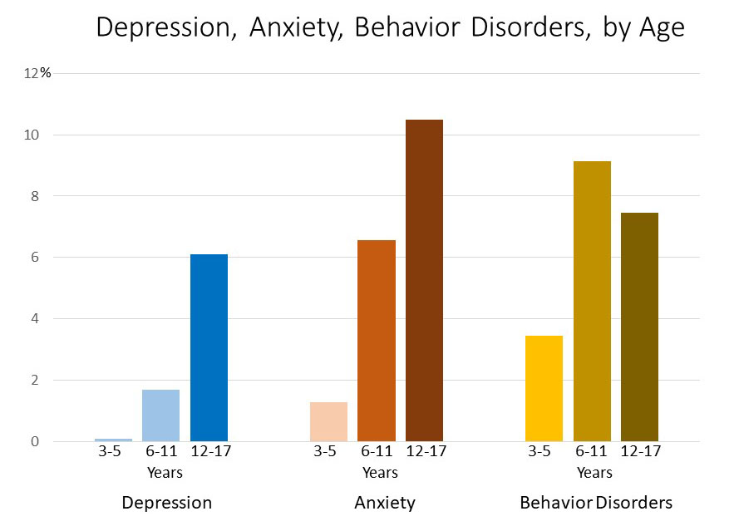

Slide 4
AnXiety, Depression, suicide in youth: Big picture
Anxiety & Depression commonly found together.
Co-occurrence of different cognitive, emotional, behavioral disorders is the RULE not the exception.
2 symptoms often associated with these
  Stomachaches
  Headaches
  Irritability
2012 data, Centers for Disease Control

Slide 5
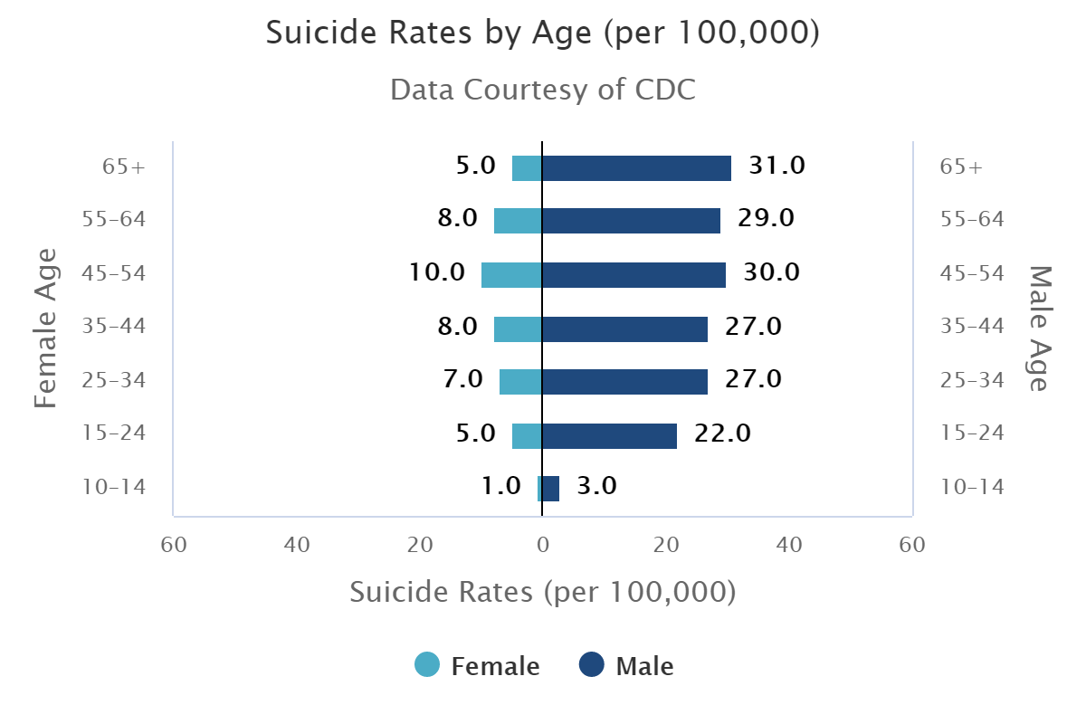
Impact
Personal suffering
Family suffering
School attendance/performance
Social, including more likely to be bullied
Economic
Health

Slide 6
Leading causes of death
10-14 years old | 15-24 years old
Unintentional Injuries (860) Suicide (520) Cancer (440) Congenital Abnormalities (190) Homicide (180) | Unintentional Injuries (13,440) Suicide (6,250 Homicide (4900) Cancer (1370) Heart Disease (910)

Slide 7
Leading causes of death, age 15-19

Slide 8
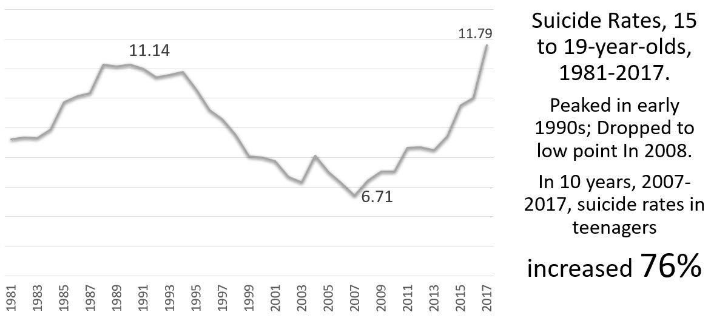

Slide 9
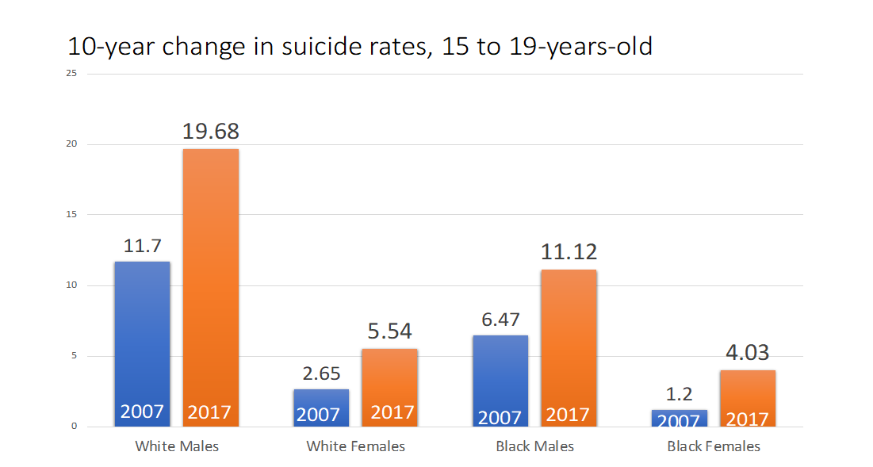

Slide 10
Gender/Ethnicity, 15-19

Slide 12
Most common Method
Firearms 45-50%

Slide 13
ideation communication planning attempts deaths

Slide 14
Risk factors

Slide 15
R I s k f a c t o r s
Demographic
Clinical
Family/Interpersonal

Slide 16
Demographics
Older people more than younger.
Men more than women.
White more than Black

Slide 17
R I s k f a c t o r s
Demographic
Clinical
Family/Interpersonal

Slide 18
Clinical risk factors
Psychiatric disorders
  Depression / Bipolar
  Alcohol / drug
  Conduct disorders
  PTSD
  Others: Anxiety, eating disorder, schizophrenia)
Nonsuicidal
Self-Injury

Slide 19
Clinical risk factors
Learning Disorders
Sleep Disturbance
Discharged from Treatment
LGBT with Distress/Non-acceptance

Slide 20
If you are with a person experiencing great psychological pain, who feels truly hopeless, you are in the room with a suicidal person.

Slide 21
R I s k f a c t o r s
Demographic
Clinical
Family/Interpersonal

Slide 22
Family / Interpersonal
Family History of Psychiatric Illness and Suicide

Slide 23
Family / Interpersonal
Family History of Psychiatric Illness and Suicide

Slide 24
Family / Interpersonal
Sexual abuse (5-fold increase)
Abuse / neglect
Bullying (bullies AND victims)
Poor peer relationships (“thwarted belongingness”)
Poor family support, increased family conflict

Slide 25
Family / Interpersonal
Sexual orientation & identity
  About 30% of LGBT youth attempt suicide at least once.
  Males>Females
Exposure to suicidal behavior
Access to firearms & other means

Slide 26
protective factors for youth
Family connectedness
School connectedness/Safe schools
Mental health services
Reduced access to firearms
Academic Achievement

Slide 27
The protective factors in one word
connectedness

Slide 28
The protective factors in one word
belonging

Slide 29
SEEK HELP FOR YOURSELF AND ENCOURAGE IT FOR OTHERS

