Slide 1
Mental health and our youth
Dale Wisely

Slide 2
Slides
www.dalewisely.com/files/

Slide 3
COVID & mental health
MH, esp. in youth, in crisis BEFORE the pandemic
Now: Demand up.
Anxiety/depression (rising for years) sharply up.
Suicide rates NOT up.
Demand up, supply grossly in adequate/access to care
Child emotional maltreatment: Before COVID, about 20% of kids reported in surveys. Most recent data: 55%

Slide 4
What about COVID? What do we know?
Interrupted school-related supports
Greatest impact likely on pre-existing MH
How did youth fare with all the insane adult behavior?
Has made access to care crisis worse
But, highly variable reactions & signs
Depression & Anxiety up, but suicide rates not.

Slide 5
Youth Mental Health: The Crisis
10% of youth will have at least one major depressive episode.
1 in 6 kids has MH diagnosis, but more like 1 in 15 experiencing serious symptoms at present
BEFORE COVID! youth getting worst of MH effects

Slide 6
No more than 20% of children with MH diagnosis received care from a mental health provider. Maybe 50% by no one. Whether kids are facing trauma because of child abuse or loss of a family member or everyday anxiety about the virus and unpredictable routines, they need even more support now—all amid a more significant shortage of children’s mental health resources.

Slide 7
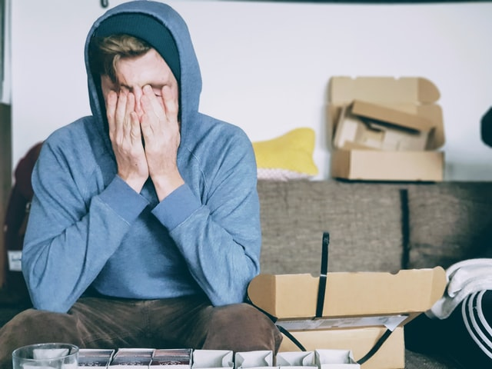
2020 survey of 1,000 USA parents: 71% said pandemic had taken a toll on their child’s mental health
69% said the pandemic was the worst thing to happen to their child. Survey of 3,300 high schoolers (spring 2020): close to a third of students felt unhappy and depressed much more than usual.

Slide 8
Mental health crisis on the rise. From March 2020 to October 2020, mental health–related emergency department visits increased 24% for children ages 5 to 11 and 31% for those ages 12 to 17 compared with 2019 (CDC)

Slide 9
Politics: MH care in schools Attacks on SEL & school counselors, a Antidiscrimination training, on programs that teach acceptance and honor diversity.

Slide 11
Dear Teacher:
Please take care of my child’s mental health, too.
Have a nice day!
The Paul Simon Principle
The Impossible Job
So much to do, but what if just a LITTLE bit of time makes a difference.

Slide 12
Emotional needs
Sense of belonging
Certainty they are loved
Sense of being able
Social interaction (rewarding) with peers
Safety & security (freedom from abuse)
Guidance & limits

Slide 13
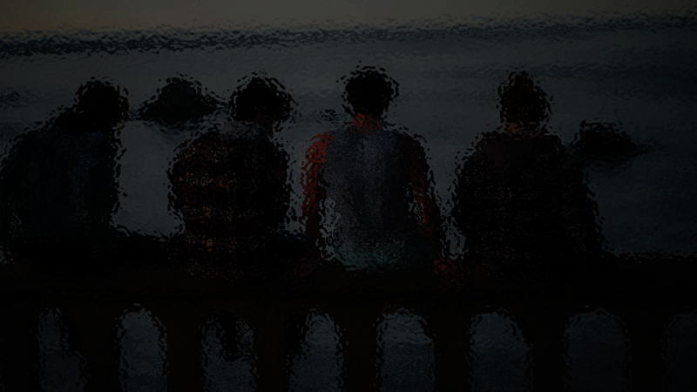
MAJOR MENTAL HEALTH PROBLEMS AMONG YOUTH
ADHD
Anxiety/Depression
Suicide & Self-Harm
Post-traumatic reactions
Substance abuse

Slide 14
MAJOR MENTAL HEALTH PROBLEMS AMONG YOUTH
ADHD
Anxiety/Depression
Suicide & Self-Harm
Post-traumatic reactions
Substance abuse

Slide 15
MAJOR MENTAL HEALTH PROBLEMS AMONG YOUTH
ADHD
Anxiety/Depression
Suicide & Self-Harm
Post-traumatic reactions
Substance abuse

Slide 16
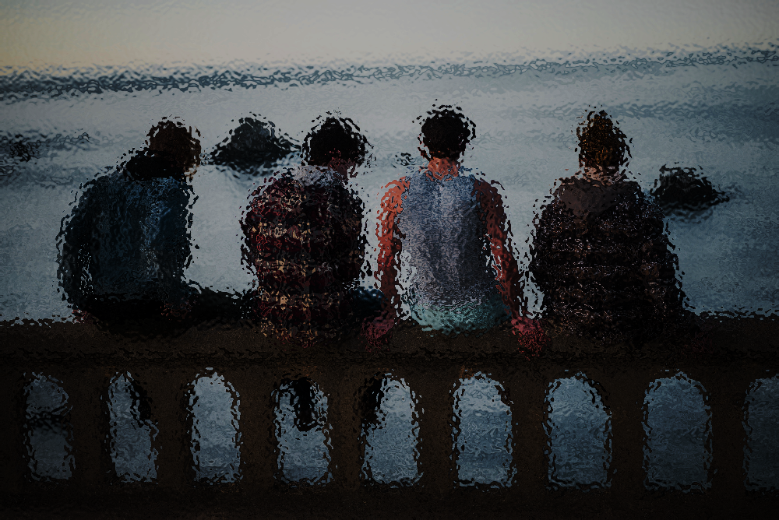

Slide 17
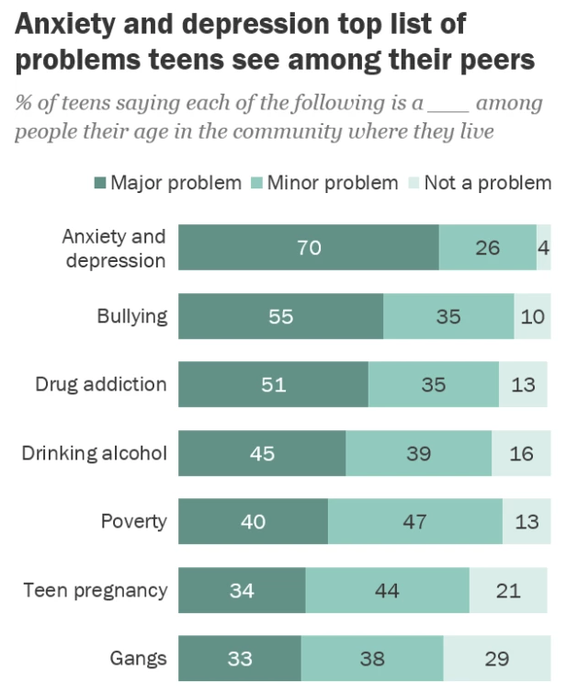

Slide 18
Symptoms of depression in youth
Sadness or hopelessness
Irritability, anger, or hostility
Tearfulness / frequent crying
Withdrawal from friends & family
Loss of interest in activities
Poor school performance
Changes in eating & sleeping habits
Restlessness & agitation
Feelings of worthlessness & guilt
Lack of enthusiasm & motivation
Fatigue or lack of energy
Difficulty concentrating
Unexplained aches & pains (headaches/stomach aches)
Thoughts of death or suicide

Slide 19
Symptoms of Anxiety in youth
Feeling nervous or "on edge.“
Perfectionism with distress
Unfounded or unrealistic fears.
Trouble separating from parents.
Sleep disturbance.
Obsessive thoughts and/or compulsive behaviors.
Trembling, sweating, shortness of breath, stomachaches, headaches, and/or muscle tension or other physical symptoms.

Slide 20
MAJOR MENTAL HEALTH PROBLEMS AMONG YOUTH
ADHD
Anxiety/Depression
Suicide & Self-Harm
Post-traumatic reactions
Substance abuse

Slide 21
suicide
a national crisis

Slide 23
15 to 19-year-olds

Slide 24
What to do?
PROACTIVELY ask child/teen directly about suicide.
Begin as early as age 9 if aware of emotional distress
routinely for teenagers.

Slide 25
The Columbia Lighthouse Project

Slide 26
Bullying what victims say helps & hurts
helped | Didn’t help or hurt
Listened to me Gave me advice Checked in with me over time | Punished other students (can hurt victims) Sat down with me & other students together Said they would talk to other students Processed it in class Brought in a speaker Talked with whole class about it Told me to work it out Told me to ignore it Told me if I acted different it wouldn’t happen Ignored me

Slide 27
questions to ask
Do you have nicknames?
What’s recess/break like for you? PE? lunch?
Have you been teased?
What kinds of things do the others tease you about?
(social media?)

Slide 28
Helping victim
praise victim’s non-violent response
assure LONG TERM availability to listen & help
be vigilant & monitor on an ongoing basis

Slide 29
MAJOR MENTAL HEALTH PROBLEMS AMONG YOUTH
ADHD
Anxiety/Depression
Suicide & Self-Harm
Post-traumatic reactions
Substance abuse

Slide 30
Emotional needs
Sense of belonging
Certainty they are loved
Sense of being able
Social interaction (rewarding) with peers
Safety & security (freedom from abuse)
Guidance & limits

Slide 31
The power of relationships. The power of the brief encounter.

