Slide 2
Substance abuse trends
Dale Wisely, Ph.D.
Clinical Psychologist
Executive Director, All In Mountain Brook
Member, Alabama Board of Examiners in Psychology

Slide 3
Your district is not an average.

Slide 4
Nationally, among youth, substance use…
Has been declining for years
Then fell sharply in 2020, 2021
Remained stable at these lower rates in 2022

Slide 5
Monitoring the Future (report 12/2022)
Reported use among 8th, 10th, 12th grade declined dramatically in 2020-2021: School closures? Social distancing? Note: This is dramatic downturn but follows years of gradual decline.
In 2022, held steady at significantly below pre-pandemic levels.

Slide 6
Monitoring the Future (report 12/2022)
Substance/ past year | 8th | 10th | 12th
Vaping | 12% | 21% | 27%
Cannabis | 8% | 20% | 31%
Vaping Cannabis | 6% | 15% | 21%
Alcohol | 15% | 31% | 52%

Slide 7
Monitoring the Future (report 12/2022)
Substance/ past year | 8th | 10th | 12th
Any illicit, not marijuana | 5% | 6% | 8%
Narcotics, not heroin |  |  | 31%

Slide 8
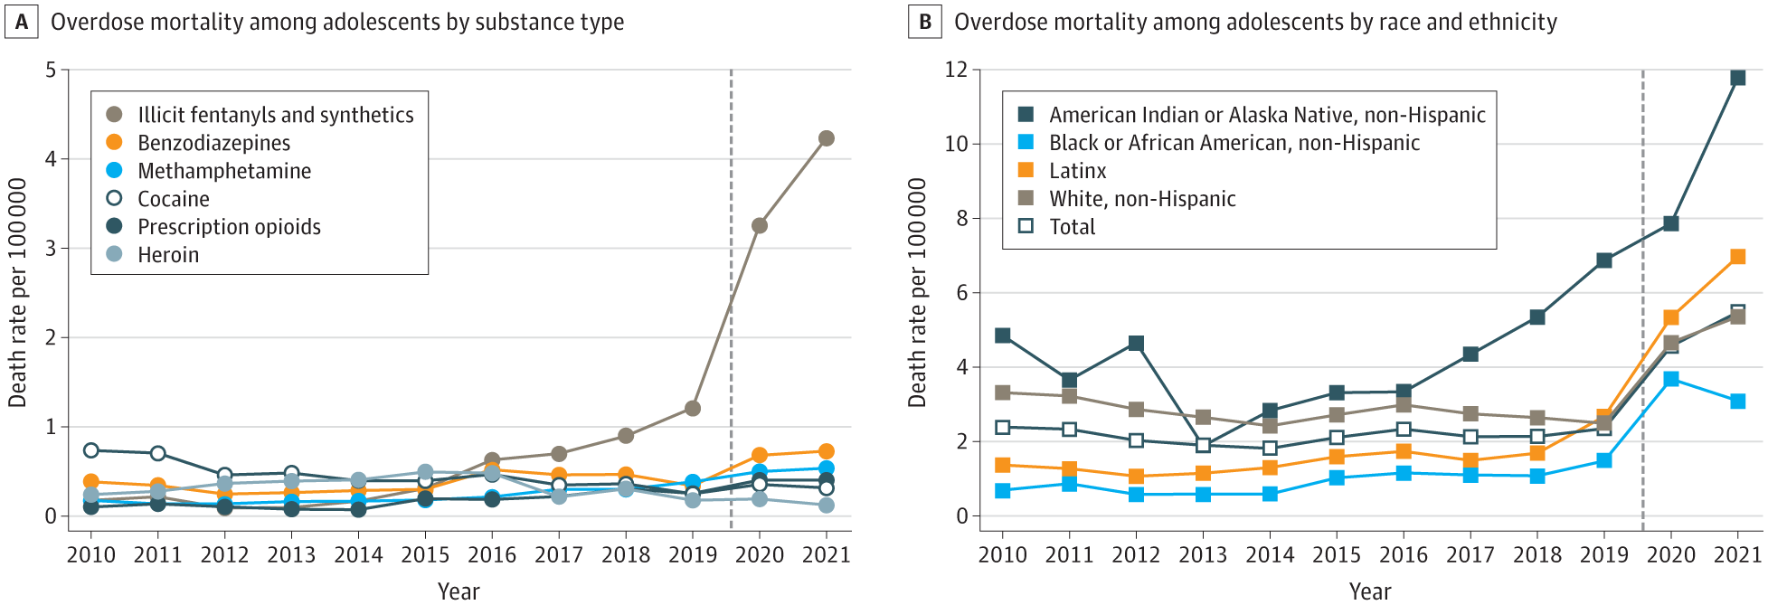
Very bad news: Increases in fatal overdoses (Friedman, Godvin, et. al. (JAMA, April 2022)

Slide 9
Mental Distress/Disorder
Suicide

Slide 10
Overdose Deaths
Overall substance use

Slide 11
Very bad news: Increases in fatal overdoses (Friedman, Godvin, et. al. (JAMA, April 2022)

Slide 13
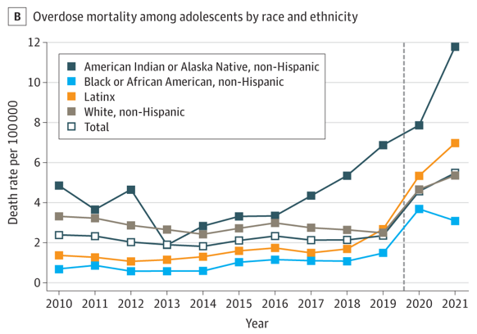

Slide 14
Overdoses ranked by ethnicity/race
Native American-American Indian/Alaska Natives
Latinx
White, non-Hispanic
Black

Slide 15
All Overdoses, adolescents (Friedman, Godvin, et. al. (JAMA, April 2022)
2010 | 2019 | 2020 | 2021
518 (rate: 2.4) | 492 (2.4) | 954 (4.6) | 1146 (5.5)

Slide 16
Fentanyl(s) Overdoses, adolescents (Friedman, Godvin, et. al. (JAMA, April 2022)
2010 | 2019 | 2020 | 2021
 | 253 (rate: 1.2) | 680 (3.3) | 884 (4.2)

Slide 17
OVERDOSES, ADOLESCENCE, by substance (some in combination)

Slide 18
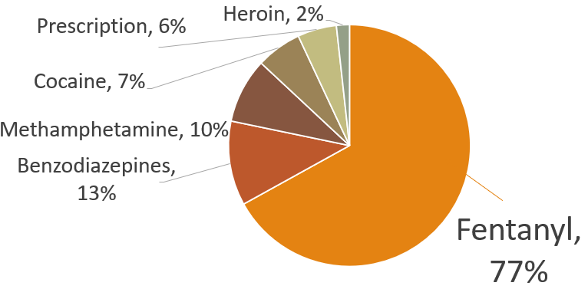
OVERDOSES, ADOLESCENCE, by substance (some in combination)

Slide 19
A word about drugs and misinformation

Slide 20
The truth is bad enough.
No need to make stuff up.
No need to spread rumors.

Slide 21
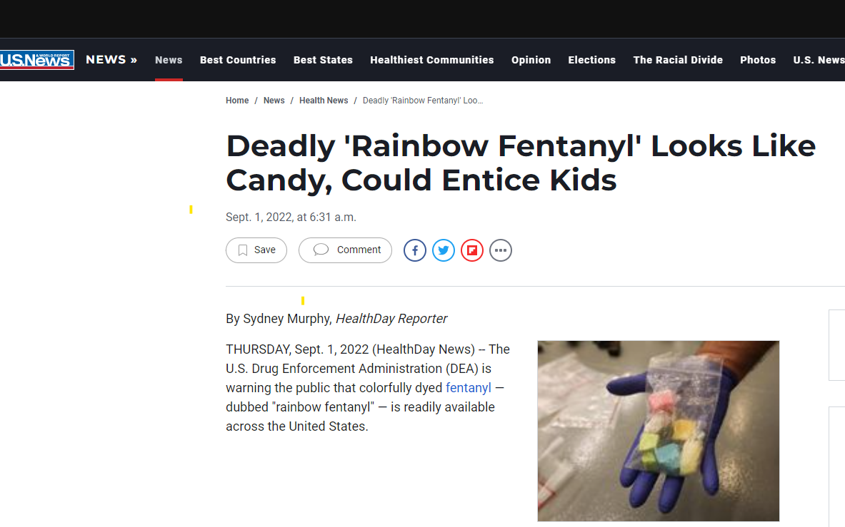

Slide 23
What’s the harm? Maybe it will help scare them away!

Slide 24
Comorbidity: Substance Use Disorders and Mental Health Disorders
Among youth, co-occurring disorders are the rule, not the exception
Depression, anxiety, ADHD

Slide 25
Consequences of underage drinking
Increased use of other drugs
Can cause academic problems
Always a leading contributor to injury / death
Legal problems
High-risk sexual activity and/or being perpetrator or victim of sexual assault
Health problems

Slide 26
Leading Causes of Death Among Teenagers and Young Adults ages 15-24
Unintentional Injuries
Suicide
Homicide

Slide 27
Leading Causes of Death Among Teenagers and Young Adults ages 15-14
Unintentional Injuries
Suicide
Homicide
95% drugs/alcohol

Slide 28
How many young people die from causes that are or are often alcohol & drug related?
Unintentional Injuries
Suicide
Homicide
95% drugs/alcohol

Slide 29
Leading Causes of Death Among Teenagers and Young Adults ages 15-24
Motor Vehicle Crashes
Drug/Alcohol Overdoses
Suicide
Homicide
Drowning / Falls Firearm deaths (unintentional)

Slide 30
If we want to keep students from dying, getting arrested, dropping out of school, & almost all bad outcomes….

Slide 31
If we want to keep students from dying, getting arrested, dropping out of school, & almost all bad outcomes….
nothing is more important than promoting mental health and substance abuse prevention and response.

Slide 32
Risk Factors & Protective Factors
Substance abuse
Risk & protective factors
Mental Health
Risk & protective factors
Shared factors

Slide 33
Way-too-short summary
 | RISK FACTORS | PROTECTIVE FACTORS
Family/ Relationships | Substance abuse in family & among friends. Mental health problems in family. | Parent information/education empowerment. Parental involvement. BELONGINGNESS
Community | Neighborhood poverty & violence | Access to pediatric, mental health care Faith-based resources After-School Activities

Slide 34
Risk factors
Cluster (as do protective factors)
Are negatively correlated with protective factors
Schools often are limited (& frustrated) by community & broader social problems.
A life saved is a life saved. (And the numbers are unknowable.)

Slide 35
Questions
Do scare tactics work?
Does random drug testing work?
Can we focus too much on “bad choices”?
Do punishments and time out of school help?

Slide 36
What may work. The big picture.
Enhancing belongingness
All pro-social efforts
All pro-mental health efforts
Do we need to teach elementary kids about individual drugs or that they are “bad”?
Programs, but also “working the cases.”

Slide 37
Two crises: Youth Mental Health Opioids, especially fentanyl

Slide 39
Opioids/fentanyl in schools: needed steps
Information to all, including students
Emphasize unintentionality (fake pills)
Variability in strength
Meds only from doctors, please
SCRUPULOUSLY avoid rumors & misinformation
Avoid “bad choice,” moralism language. Destigmatize

Slide 40
Training / Drills
Know signs of overdose
Gurgling/snoring
Extreme drowsiness, asleep, can’t wake ‘em up.
Cold/clammy
Grey/blue skin/lips/nails
Narcan
Address fears about Narcan and about accidental exposure.

