Slide 1
Treatment
Adult Education
Medication
Professional care/monitoring
Management at school
Management at home

Slide 2
School and ADHD

Slide 3
The ideal educational program
Education about ADHD to student, parents, and educators
Better understanding of strengths, weaknesses, impairments
Reasonable goals, with balanced life in mind, monitored and revised
Skills to address executive function deficits

Slide 4
Just know…
You have to advocate for your child.
Number of students with disorders and disabilities has expanded rapidly.
Range of measures we are expected to take for each child has expanded.
Resources, and funding, have not expanded.

Slide 5
Things to discuss with school
Staff training on ADHD. (When was the last time & how much?)
What is our plan for this student with ADHD?
Section 504 and Special Education
Reduction of homework
Consideration of role of impulsivity in disciplinary matters.

Slide 6

The curse:
Almost no one the student encounters truly understands the disorder.

Slide 7


Homework
Reduce as much as you are able and willing, provide more time WITH PROMPTS and support.

Slide 8
Parenting

Slide 9


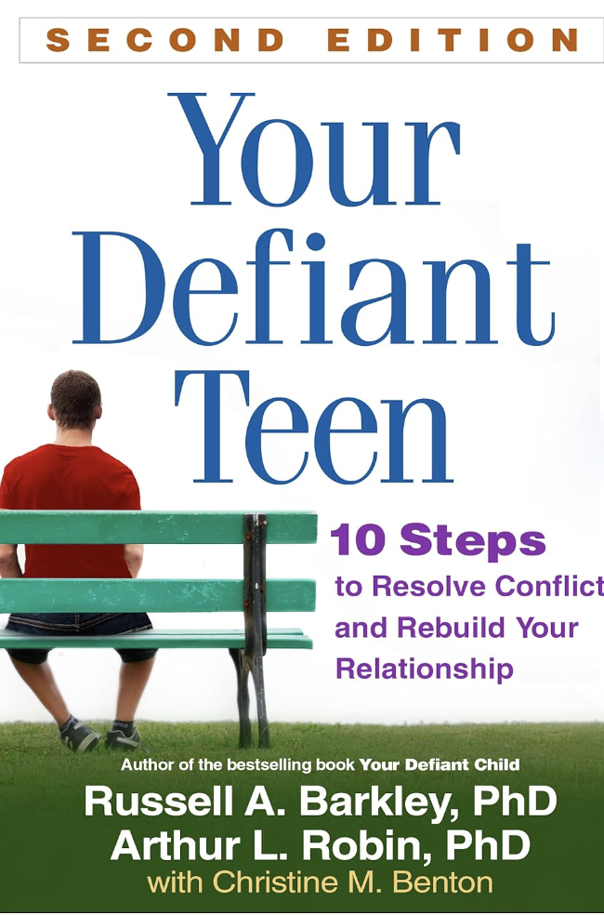

Slide 10

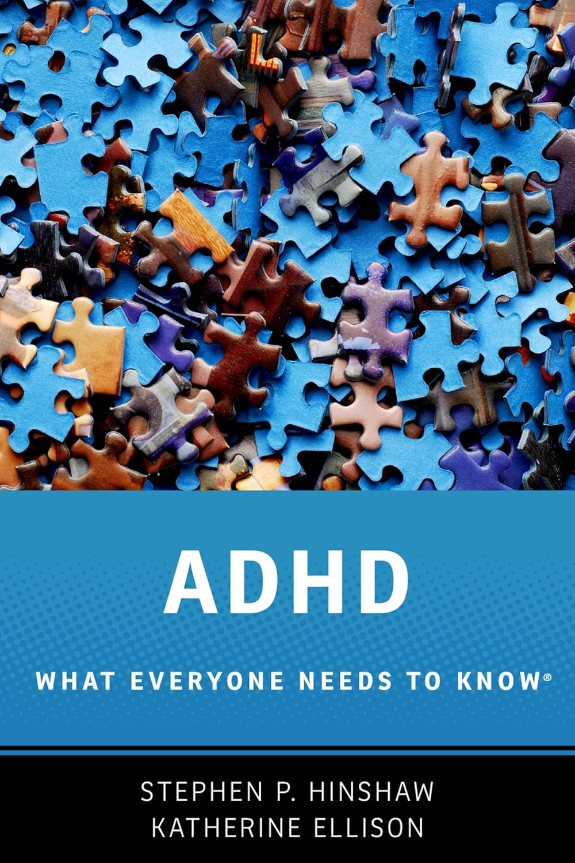

Slide 11
The ADHD family
ADHD, among other things, is about trouble with focus & attention, impulsivity and hyperactivity, and poor regulation of emotions.
ADHD is very often hereditary, meaning an excellent chance at least one parent may have it, maybe a sibling or two.

Slide 12
ADHD FEATURE | Family impact
Inattention/Focus | Pay attention! How many times have I told you? You never mind me! You’re so smart, what’s with these grades?!
Hyperactivity/ Impulsivity | How could you have done that?! What were you thinking?!
Emotional Dysregulation | Calm down! (No, YOU calm down!) Lots of frustration, conflict, shouting, fussing-at.
Hereditary nature | Parent with ADHD has trouble following through and being consistent, and has trouble controlling emotional reactions to child’s behavior.

Slide 13

Parenting
It’s hard.
No shortcuts or easy answers.
Keeping disability perspective.
Avoid judging your child’s character or motives.

Slide 14
Russell Barkley’s Principles (modified)
Give child more feedback & consequences, more frequently.
Use larger and more powerful consequences.
Use incentives before punishment.
Help with keeping up with time.

Slide 15
Russell Barkley’s Principles (modified)
Strive for consistency.
Act, don’t yak.
Plan ahead for problem situations.
Don’t personalize your child’s problems.
Practice forgiveness.
Take care of yourselves.
Use a solid discipline program

Slide 16

a discipline program
Appropriate use of time-out (up through puberty)
Shifting balance of positive and negative interactions
Acknowledging good behavior. Fuss less.
Avoid corporal punishment
Parental control of parental anger

Slide 17
Define age-appropriate, attainable goals
Systematically reward each small achievement until behavior becomes routine.
By rewarding positive behavior (rather than punishing negative behavior), you help your child feel successful — and further increase his motivation to do the right thing.

Slide 18
“discipline”
related to our overall relationship with child
it must change as child develops
based on mutual respect
children differ in how much they need “discipline.”

Slide 19
Effective “discipline”
occurs only when we have a handle on our own personal and emotional lives.
occurs only when we have no ax to grind with child.
requires a balance of negative and positive.

Slide 20
Effective discipline
isn’t always effective.
requires planning, patience, and not operating on the fly.

Slide 21
Discipline harder with ADHD
More trouble attending to “commands.”
More trouble persisting when trying to respond to commands.
Rewards tend to wear off.
Punishment not as effective.
Spanking, at best, a waste of time.
The “bad kid” role: “You NEVER listen. You NEVER mind.”

Slide 22
Our Responsibilities
Being clear in communicating rules & expectations.
Controlling our emotions during disciplinary moments.
Not fighting dirty, name-calling, being hurtful.
Being more mature than our children.

Slide 23
What works?
Planning, forethought, patience.
Communicating effectively
Controlling our emotions and impulses.
Being self-confident and showing it.

Slide 24
What works?
Not allowing ourselves to be ruled by children’s emotions & desires.
Logical & Natural consequences of behavior.
Time-Out combined with “Time-In”
Connecting behavior with privileges, naturally.

Slide 25
Teaching your child to listen (and mind)
Dale Wisely, Ph.D.

Slide 26

Which children have trouble listening and minding?

Slide 27
Why won’t my child listen?
Don’t take it personally.
It’s a part of growing up.
It’s a process.

Slide 28
Why won’t my child listen?
Ability to listen & mind must…
      develop
      be learned (and taught)
It’s a process. And kind of a long one

Slide 29

Why won’t my child listen?
Can I make my own decisions yet?
Testing limits is normal and necessary.

Slide 30

Ineffective communication
by parents.

Slide 31

Teaching your child to listen (and mind)

Slide 32

#1. Be heard. Literally
Hailing
  Call name, await response
Orienting
  Eye contact
Phrasing
  “Would you do Mom a favor and sometime do” x?
  vs.
  “Please do” x “right away.”

Slide 33

#2. Prepare the child for problem situations.
Here’s what’s going to happen.
Here’s what I expect.

Slide 34
#3. Inform. Don’t accuse.
Accusations REQUIRE people to defend themselves.

Slide 35
ACCUSATION | INFORMATION
You always leave your dirty clothes on the floor! | Dirty clothes belong in the hamper.
Stop yelling! | I hear you better with a calm voice.
HURRY UP!! | Time is short, please make your choice.

Slide 36
#4. Ask questions to prompt solutions.
NAG | QUESTION
How many times have I told you to wash your face!? | What can you do to get your face clean?
Take out the garbage! | What job did you agree to do earlier?
GET DRESSED! | What is the best way to get dressed so we can be on time?

Slide 37
#4. Ask questions to prompt solutions.
NAG | QUESTION
Don’t eat that crap! | What are healthy food choices?
Why are you acting like this in the store? | How will you let me know you are tired and ready to go home?
You can’t watch that show! | How can we be sure you are watching appropriate shows?

Slide 38


Slide 39
use of spanking as disciplinary tool–
increases aggression in young children in long run
is ineffective in teaching responsibility & self-control.
American Academy of Pediatrics

Slide 40
use of spanking as disciplinary tool–
New evidence: may cause harm to child by affecting brain development
Other methods that teach children right from wrong are safer & more effective.
American Academy of Pediatrics

Slide 41
positivity
Acknowledging goodness
Working on relationship: Trust, affection
Spending no-agenda time together

Slide 42

positivity
Acknowledging goodness
Working on relationship: Trust, affection
Spending no-agenda time together

Slide 43

Spending no-agenda time together

Slide 44
Disclaimer!
For children with developmental, medical, physical, behavioral, and emotional difficulties, parents should seek guidance from health care professionals with a professional relationship with their children.
Nothing in this talk should take the place of professional consultation.
Parents with difficulties controlling their anger when disciplining their children should seek professional guidance.

Slide 45
Why won’t my child listen?
Parents inadvertently teach child not to listen until screamed at.

Slide 46


Slide 48
Did I hear something?
She’s not mad yet.
I’m good.
She’s not that mad yet. I’m good.
Uh-oh. Getting close.
She’s screaming, better get up and do it.

Slide 49
Breaking out of the spiral.
1 directive
1 warning
1 consequence

Slide 50
Begin with preparation.
1 directive, given properly.
  Compliance?: Acknowledge, thank.
  No compliance?:
1 warning.
  Warning: If you don’t do what I say, then (consequence.)
  Compliance? Acknowledge, thank.
  No compliance:
Consequence applied.
  When the warning is ignored, don’t accept “OK, OK, I’ll do it!”

Slide 51

Time-out does not work without time-in!

Slide 52
What triggers time-out?
clear DIRECTION
WARNING
CHILD DOESN’T MIND

Slide 53

What triggers time-out?
CLEARLY ESTABLISHED RULE BROKEN
ESPECIALLY AGGRESSION

Slide 54
GUIDELINES for first use
Calmly, confidently explain procedure in advance of starting your T-O program
Be prepared to spend some time getting over “the hump”

Slide 55
GUIDELINES
Purpose: To remove child from reinforcement of misbehavior OR from what s/he is doing INSTEAD of what you directed them to do.

Slide 56
GUIDELINES
Announce time-out with as few words as possible
Observe while in time-out
No eye contact, no talking

Slide 57
GUIDELINES
Child must not be doing anything: Isolate from others as much as possible. No interaction!

Slide 58
GUIDELINES
1 to 5 minutes in time-out, with added time as needed to get calm (sad / angry OK, bad behavior not OK)
Move on when it’s over. Don’t talk about it.

Slide 59

Troubleshooting?

Slide 60
What about adolescents / teens?

Slide 61
How do we deal with…disrespect, challenging, noncompliant behavior in an adolescent or teenager?
Don’t be reactive and impulsive. Take a longer-haul approach with consequences linked to behavior.

Slide 62

Does it really matter if I follow the rules?

Slide 63
What do we owe our kids?

Slide 64
The non-negotiables
  Food & Water
  Shelter
  School
  Healthcare
  Clothing
  Protection from (some) danger

Slide 65
Raising the unspoiled child?
Provide your child’s needs and make the rest a “deal”.
The deal: I, as your parent, will enrich your life in exchange for respect, civility, basic obedience, you taking care of your responsibilities, etc.

