Slide 1


Slide 2

Understanding & preventing suicide

Slide 3
Suicide rates

Slide 4
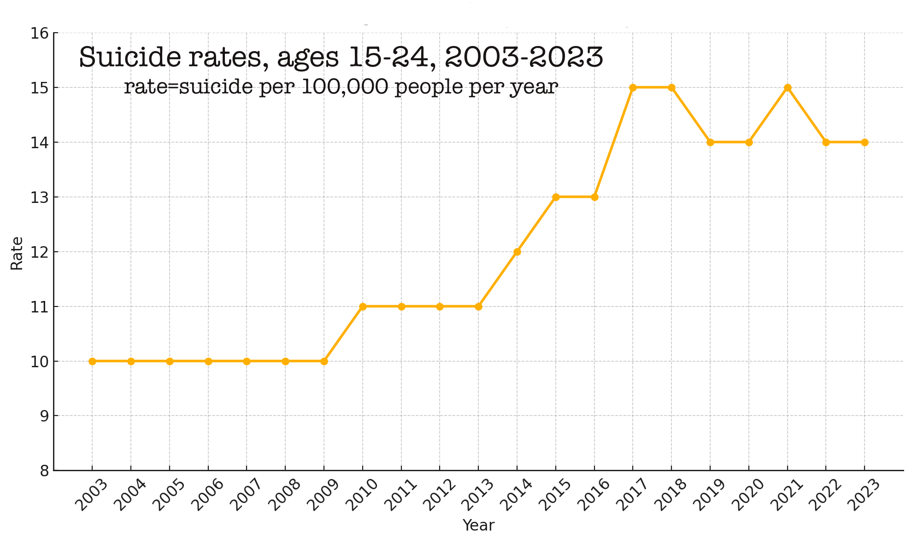

Slide 5
Suicide Rates 15-24 USA

Slide 6
Suicide rates by age group, USA 2022

Slide 7
2022 suicide rates by sex
6

Slide 8
2018-2022 Suicides by 6 “races”

Slide 9
In the general U.S. population, 2024
48,824 suicides
135 per day, one every 11 minutes.
1 young person per hour
11th ranking cause of death
2ND ranking cause of death in young people, after accidents.

Slide 10
12.3 million adults seriously thought about suicide
3.5 million made a plan
1.7 million attempted suicide
49,000 died by suicide

Slide 11
Elevated risk/rates (deaths per year per 100,000 people in population)
Males: 4 to 1
Ethnicity (rates)
  Non-Hispanic American Indian: 28
  Non-Hispanic White: 17
  Non-Hispanic Multiracial: 10
  Non-Hispanic Black: 9
  Asian: 7

Slide 12
method
Firearms: 55%
Suffocation: 26%
Poisoning: 12%
Other: 8%

Slide 13



Slide 14
Domains of suicidal experience
THOUGHTS
(ideation)
COMMUNICATIONS
(comments, writings, threats, “gestures.”)
BEHAVIOR
(gestures, attempts, reckless behavior, non-lethal self-injury, lethal self-injury.)

Slide 15
Suicide-related behavior
Many people have fleeting suicidal thoughts.
Fewer (but many) seriously consider suicide.
Even fewer (but many) make a plan.
Still fewer (but too many) attempt.
Even fewer (but too many) die by suicide.

Slide 16
Demographic differences
Men more than women
White more than Black
Old more than young

Slide 17
Demographic differences
GENDER:
  Men die by suicide 4 times more often than do women.
  Women attempt suicide much more often than do men.

Slide 18
Demographic differences
ETHNICITY
  White people are much more likely to die by suicide than black people.
  Native Americans have higher suicide rates than whites.

Slide 19
Demographic differences
AGE
  Suicide rates climb with age. Elderly have highest rates.
  Lowest rates: Children, then teens.
  Greatest increases in last 10 years are among those 45-65 y.o. (30%)

Slide 20
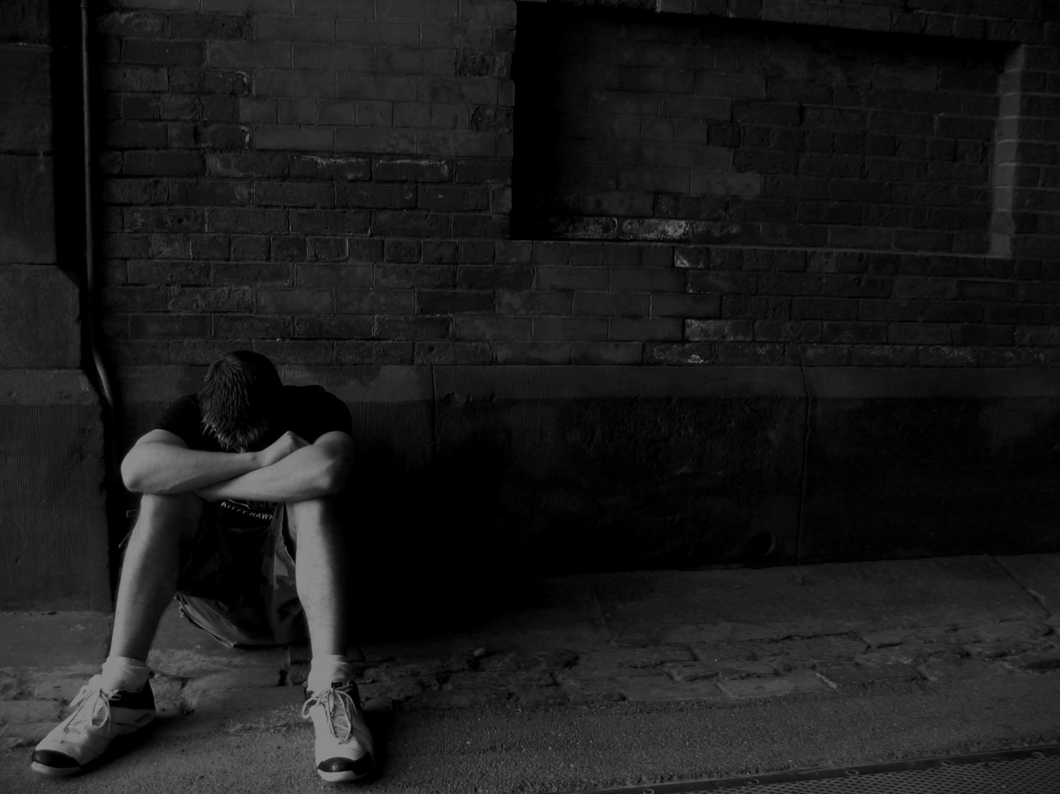
Major risk factors for suicide
Family conflict
Mental disorders
Previous attempts
Physical illness
Social isolation
Unemployment
Others

Slide 21
Mental disorders
Major Depressive Disorder (2-6%)
Bipolar Disorder (15-fold increased risk compared to population).
Borderline Personality Disorder (4-5%)
Anorexia Nervosa (58 times more than expected)
Schizophrenia (2-6%)
Substance Abuse (6 times general population)
Conduct Disorder (youth) (6 times higher than controls)

Slide 22
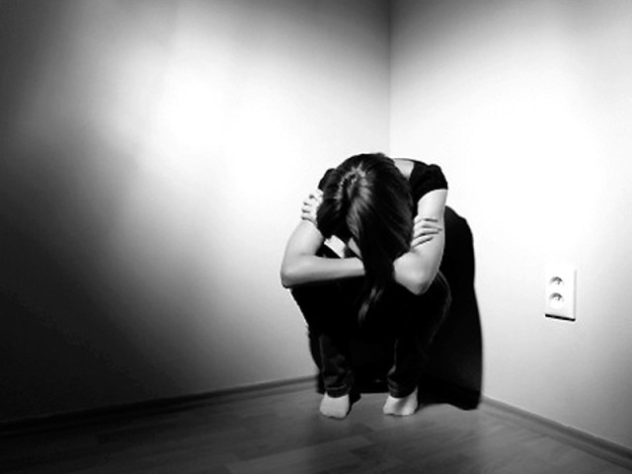
At least 95% of deaths by suicide are among people with mental disorders. However, more than half of people who died by suicide did not have a known mental health condition.

Slide 23
But the vast majority of people with these disorders do not die of suicide.

Slide 24
Many factors contribute to suicide among those with & without mental health conditions
Relationship problem (42%)
Problematic substance use (28%)
Crisis in the past or upcoming two weeks (29%)
Criminal legal problem (9%)
Physical health problem (22%)
Loss of housing (4%)
Job/Financial problem (16%)

Slide 25
10 insights from research
American Foundation for Suicide Prevention
https://afsp.org/what-we-ve-learned-through-research/

Slide 26
National College Health Assessment (Fall 2025)
 | Men | Women | Total
Serious psychological distress | 15% | 22% | 21%
Positive for loneliness | 45% | 48% | 48%
Positive suicide screening | 24% | 27% | 29%
Suicide attempt | 3% | 2% | -
Anxiety Diagnosis (self-report) | 18% | 42% | 37%
Depression Diagnosis | 15% | 30% | 28%
OCD Diagnosis | 3% | 9% | 8%
Depression + Anxiety | 11% | 27% | 24%
American College Health Association

Slide 27
Insights from research
Suicide is related to brain functions that affect decision-making and behavioral control, making it difficult for people to find positive solutions
Limiting a person’s access to methods of killing themselves dramatically decreases suicide rates in communities
Ninety percent of people who die by suicide have an underlying — and potentially treatable — mental health condition

Slide 28
Depression, bipolar disorder, and substance use are strongly linked to suicidal thinking and behavior
Specific treatments used by mental health professionals — such as Cognitive Behavior Therapy-SP and Dialectical Behavior Therapy — have been proven to help people manage their suicidal ideation and behavior

Slide 29
No one takes their life for a single reason. Life stresses combined with known risk factors, such as childhood trauma, substance use — or even chronic physical pain — can contribute to someone taking their life
Asking someone directly if they’re thinking about suicide won’t “put the idea in their head” — most will be relieved someone starts a conversation

Slide 30
If someone can get through the intense, and short, moment of active suicidal crisis, chances are they will not die by suicide

Slide 31
Warning signs
survivors of a suicide often say that the intention was hidden from them. It is more likely that the intention was not recognized.
Recent suicide, or death by other means, of a friend or relative.
Previous suicide attempts.
Preoccupation with themes of death or expressing suicidal thoughts.
Depression, conduct disorder, substance abuse, particularly when two or more of these are present.

Slide 32
Warning signs
Giving away prized possessions/ making a will or other final arrangements.
Major changes in sleep patterns - too much or too little.
Sudden and extreme changes in eating habits/ losing or gaining weight.
Withdrawal from friends/ family or other major behavioral changes.
Dropping out of group activities.

Slide 33
Warning signs
Personality changes such as nervousness, outbursts of anger, impulsive or reckless behavior, or apathy about appearance or health.
Frequent irritability or unexplained crying.
Lingering expressions of unworthiness or failure.
Lack of interest in future.
A sudden lifting of spirits, when there have been other indicators, may point to a decision to end the pain of life through suicide.

Slide 34
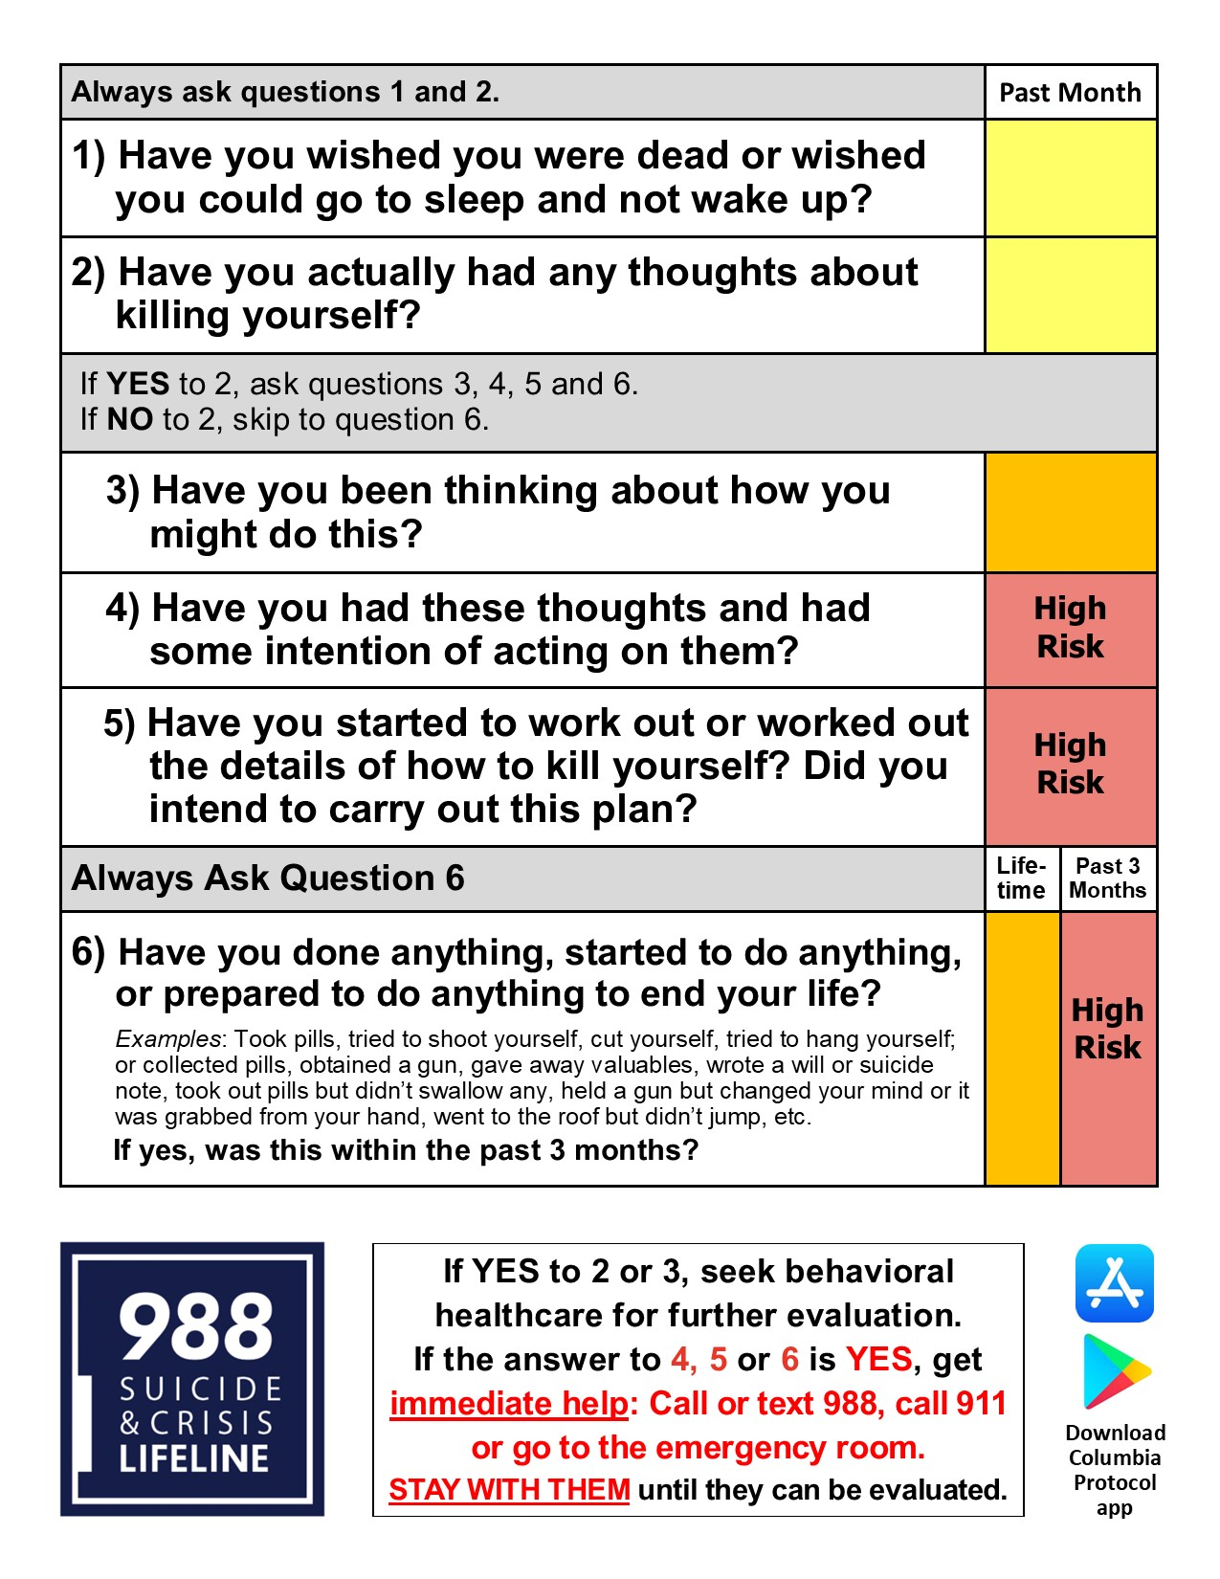
Columbia suicide protocol

Slide 35
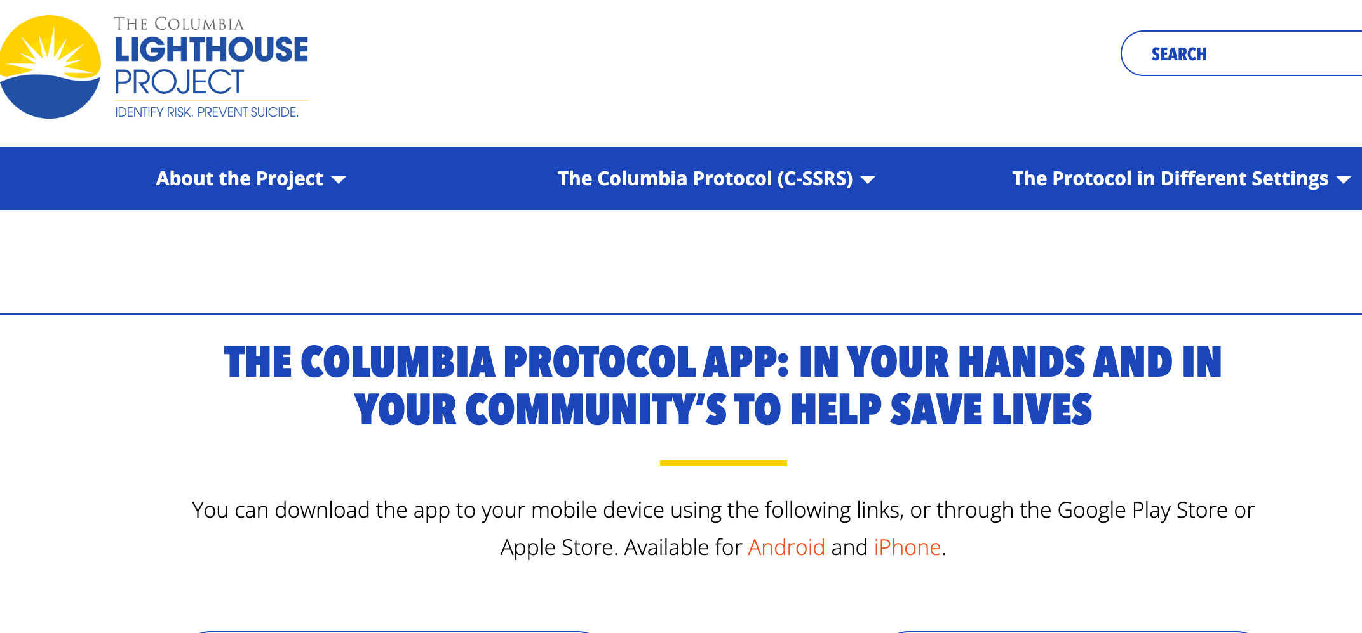

Slide 36
CRISIS CONTACTS
24/7 CRISIS CENTER LINE: 205-232-7777
988
SAMFORD: EXT. 2020 OR (205) 726-2020

Slide 37
”The Gap”
Training people to ask about suicide improves their KNOWLEDGE, their ATTITUDES about asking about suicide, their INTENTION to ask.
But it does not increase the actual behavior of asking.
Please be an exception

Slide 38




Slide 39

I am glad you are here.
Stay. You are needed.

