Slide 1

New Approaches to Motivation:
HIGH STANDARDS, VISIBLE RESPECT
.

Slide 2
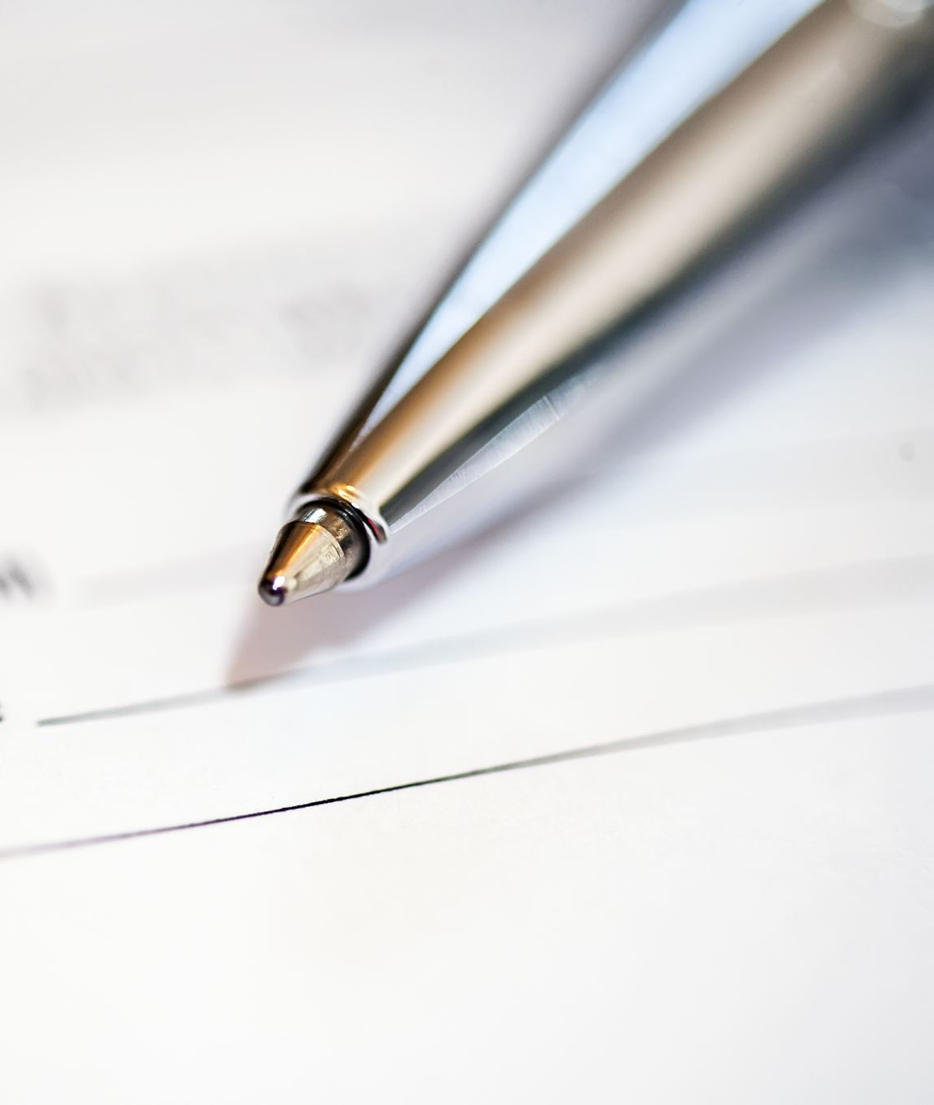
Confidential Self-Assessment
Answer 12 questions.
Don’t overthink.
Try to answer with what you believe you would do, not what you might aspire to.

Slide 3
Email from student:— “I'm not sure I can get the paper in on Friday. Things have been really bad. Can I get an extension?”
Viable, Defendable Reply A
Viable, Defendable Reply B
The late policy is in the syllabus — grades reduced 10% per day. So, try to get in as soon as you can so that penalty doesn’t compound.
Take the weekend — that’s your “free” extension mentioned in the syllabus. No explanation needed. Bring me what you have Thursday at 2:00 and we’ll see how it’s going.”

Slide 4
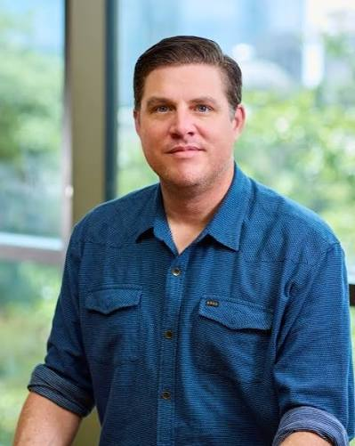

David Yeager, Ph.D.
U. of Texas-Austin

Slide 5
Two stories we tell about students.
They’re mostly wrong.

Slide 6
I. The Generation Myth
The widely-accepted and mostly wrong claim
Cohorts of people (born inside a range of years) share traits that distinguish them from people born outside it—and those traits explain why, for example, these students won’t do the reading.
Baby Boomers — 1946–1964
Generation X — 1965–1980
Millennials (a.k.a. Gen Y) — 1981–1996
Generation Z — 1997–2012

Slide 7
The Generation Myth
The widely-accepted and mostly wrong claim
Is it that they are Gen Z or is it that they are 19 years old?
The age ranges are arbitrary, mostly about marketing, & not data-driven.
The purported differences are small, inconsistent, or absent.
Cohorts of people (born inside a range of years) share traits that distinguish them from people born outside it—and those traits explain why, for example, these students won’t do the reading.

Slide 8
The perennial complaint

Slide 9
The perennial complaint
“They’re less prepared, less serious, less hard-working, more entitled.”

Slide 10
A claim that is true in every era is not describing a generation.
It may be describing what it feels like to be older than our students.
The perennial complaint
“They’re less prepared, less serious, less hard-working, more entitled.”

Slide 11
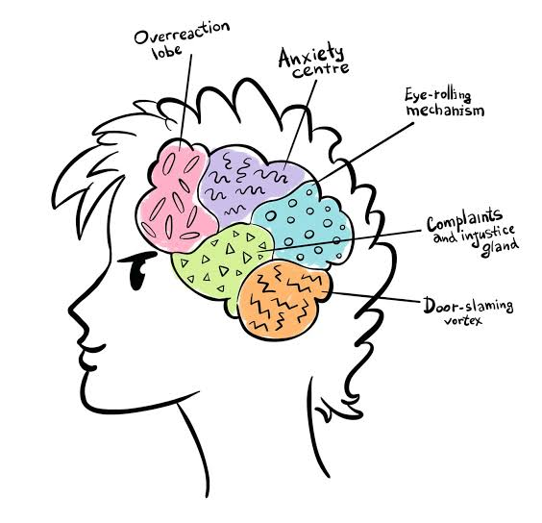
Their brains are not developed, so…
II. The TEENAGE BRAIN Thing

Slide 12
The “Teenage” Brain (but through mid-20s)
True:
False:
The maturation of the prefrontal brain continues into the mid-20s.
Risk-assessment is less well- developed.
Social status and standing is a highly active motivator.
That this predicts individual students’ behavior.
That students are incapable of making good decisions.
That students are incapable of sound judgment.

Slide 13


Slide 14
24 years old
Graduated near top of college class
Now a 2nd year grad student.
Extensive volunteer work.
Organized and planned a successful fundraiser
Travels home regularly to support a parent who has a chronic illness.

Slide 15
All this with her poor little underdeveloped prefrontal cortex.

Slide 16
The reframe
“
From roughly ten to twenty-five, motivation tends to reorganize around status and respect —being taken seriously by people whose opinion matters.
Notes:
Yeager, 10 to 25 (2024). The claim is not that young people are status-obsessed and adults are not — it is that the weighting is unusually high in this window, and that contribution and competence are the currencies, not popularity.
The practical consequence: anything that reads as public disrespect is expensive, and anything that offers a legible route to earned competence is cheap.

Slide 17
Both myths, “This Generation” & “Teenage Brain” allow us to blame and scapegoat youth for our failings, individual or systematic
01.
02.
03.
The problem is their birth year.
The problem is their prefrontal cortex.
The problem ain’t us.

Slide 18
Scoring
Note: this scale is not validated. I made it up.
Step 1 — Standards score (odd-numbered items)
one point for each of these: 1-A 3-B 5-B 7-B 9-A 11-B
STANDARDS SCORE: ______ / 6: 0-3 (low) 4-6 (high)
Step 2 — Support and respect (even-numbered items)
one point for each of these: 2-B 4-A 6-A 8-B 10-B 12-A
SUPPORT SCORE: ______ / 6: 0-3 (low) 4-6 (high)

Slide 19
Yeager’s adaptation of Baumrind’s parenting types, 1971
Two axes, four postures
PROTECTOR
MENTOR
HIGH
SUPPORT
low standards · high support
high standards · high support
0-3 on Standards
4-6 on Support
High score (4+) on both standards & support
AVOIDER
ENFORCER
LOW
SUPPORT
low standards · low support
high standards · low support
Low score (0-3) on both standards and support
4-6 on Standards
0-3 on Support
LOW STANDARDS
HIGH STANDARDS
Notes:
Yeager emphasizes three postures; the low-low corner is the logical remainder and he says little about it. If someone asks, the honest lineage is Baumrind's parenting typology from 1971, where the fourth cell is 'neglectful.' Same two axes, fifty years earlier.
Say plainly: this is not a personality test. Most of us are one quadrant with our strong students and another with the ones who worry us.

Slide 20
Yeager’s adaptation of Baumrind’s parenting types, 1971
Two axes, four postures
PROTECTOR
MENTOR
HIGH
SUPPORT
low standards · high support
high standards · high support
Warm. “Nice”. Quick to reduce the demand.
Holds the bar. Adds the resources.
AVOIDER
ENFORCER
LOW
SUPPORT
low standards · low support
high standards · low support
This is rare as a stance. More common as when we are overwhelmed.
The bar is mine. Meeting it is your problem.
LOW STANDARDS
HIGH STANDARDS
Notes:
Yeager emphasizes three postures; the low-low corner is the logical remainder and he says little about it. If someone asks, the honest lineage is Baumrind's parenting typology from 1971, where the fourth cell is 'neglectful.' Same two axes, fifty years earlier.
Say plainly: this is not a personality test. Most of us are one quadrant with our strong students and another with the ones who worry us.

Slide 21
Yeager’s adaptation of Baumrind’s parenting types, 1971
Two axes, four postures
Maybe a better word that “standards” is “demands.”
Or “requirements”
(No educator thinks they have low standards.)
PROTECTOR
MENTOR
HIGH
SUPPORT
low standards · high support
high standards · high support
Warm. Quick to reduce the demand.
Holds the bar. Adds the resources.
AVOIDER
ENFORCER
LOW
SUPPORT
low standards · low support
high standards · low support
Rare as a stance. Common as a drift.
The bar is real. The path is your problem.
LOW STANDARDS
HIGH STANDARDS
Notes:
Yeager emphasizes three postures; the low-low corner is the logical remainder and he says little about it. If someone asks, the honest lineage is Baumrind's parenting typology from 1971, where the fourth cell is 'neglectful.' Same two axes, fifty years earlier.
Say plainly: this is not a personality test. Most of us are one quadrant with our strong students and another with the ones who worry us.

Slide 22
ENFORCER
PROTECTOR
passes for rigor
passes for compassion
“The standard is the standard.”
“I'm not here to hold hands.”
“The syllabus answers that.”
“Let's make this more manageable.”
“Don’t worry about the deadline”
“I'll drop the lowest two.”
From the desk it reads as: you don't think I can do the real thing. Or (worse?) reinforces that sense in the student.
From the desk it reads as: I just have to get through this. I have to do what I must just to pass.
Notes:
Name the local truth: at a place like Samford, where people are drawn to the work because they care about students, the protector drift is the more common failure and the harder one to see. Enforcers get told. Protectors get thanked.
The sharpest version: lowering the bar communicates an estimate of the student's ceiling more loudly than anything you say about believing in them.

Slide 23
Mentor
True rigor + compassion
“What do you see as getting in the way of you meeting the standard?”
”What can I do to help?” “Think about it and don’t be afraid to ask.”
“What kind of support do you need to meet the standard?”

Slide 24
Two words, reconsidered
“Unmotivated”
Usually: sees no route to standing through this course. Effort here buys nothing that matters.
“Entitled”
Often: is testing whether the standard is real or arbitrary — because arbitrary standards are the ones that have hurt them before.
Notes:
Invite a third: 'What else do we say?' Take one or two from the floor and retranslate on the spot. This is the moment the room starts doing the work instead of watching you do it.
Common offerings: 'checked out,' 'fragile,' 'grade-grubbing.' The last one is the richest — grade-grubbing is almost always a status negotiation, and treating it as greed guarantees you handle it badly.

Slide 25
1
Give wise feedback
Attach the standard and your confidence to the feedback.
“I'm giving you these comments because I know I ask a lot in my class and I know you can do it.”
Questions:
How much time does it take to add this?
Could it help?
Any possibility of harm?
Notes:
Be scrupulous about the numbers: these are Study 1, seventh graders, and the effect was concentrated among Black students, who had the most reason to wonder whether the criticism was about the work or about them. Do not generalize the percentage to your own classroom.
The transferable mechanism is what to generalize: critical feedback is ambiguous, the student resolves the ambiguity, and one sentence tells them how. Faculty audiences trust you more when you draw that line yourself.

Slide 26
2
Ask Before You Tell (or privately draw conclusions)
What’s your read about what happened here?
What did you think the assignment was asking for?
What might you do differently next time?
If you need it, will you ask me for help or support?
Notes:
Be scrupulous about the numbers: these are Study 1, seventh graders, and the effect was concentrated among Black students, who had the most reason to wonder whether the criticism was about the work or about them. Do not generalize the percentage to your own classroom.
The transferable mechanism is what to generalize: critical feedback is ambiguous, the student resolves the ambiguity, and one sentence tells them how. Faculty audiences trust you more when you draw that line yourself.

Slide 27
3
Say why the standard is what it is. What’s it for?
Not just what is required, but why.
If they don’t know the rationale, it seems like arbitrary authority, which leads to disengagement, then often diagnosed as laziness.
Notes:
Be scrupulous about the numbers: these are Study 1, seventh graders, and the effect was concentrated among Black students, who had the most reason to wonder whether the criticism was about the work or about them. Do not generalize the percentage to your own classroom.
The transferable mechanism is what to generalize: critical feedback is ambiguous, the student resolves the ambiguity, and one sentence tells them how. Faculty audiences trust you more when you draw that line yourself.

Slide 28
4
With student distress, add resources rather than lowering the bar.
Enforcer (High Standards, Low Support).
“Manage. Rearrange your priorities.”, etc.
Protector (Low Standards, High Support).
“Sounds like you’ve just got too much, so let me reduce demands on you.”
Mentor: (High Standards, High Support).
“The bar I’ve set for the class stands. Let’s help you build the resources to meet it. I believe you can do it.”
Notes:
Be scrupulous about the numbers: these are Study 1, seventh graders, and the effect was concentrated among Black students, who had the most reason to wonder whether the criticism was about the work or about them. Do not generalize the percentage to your own classroom.
The transferable mechanism is what to generalize: critical feedback is ambiguous, the student resolves the ambiguity, and one sentence tells them how. Faculty audiences trust you more when you draw that line yourself.

Slide 29
4
A difficulty with “I believe you can do it.”
Many students believe anything short of an A means they DIDN’T meet the standards.
“I believe you can do it” it might be met with “How do you know that?” or “That sounds like something you just SAY.”
So, works better in context of taking time to talk with the student.
Notes:
Be scrupulous about the numbers: these are Study 1, seventh graders, and the effect was concentrated among Black students, who had the most reason to wonder whether the criticism was about the work or about them. Do not generalize the percentage to your own classroom.
The transferable mechanism is what to generalize: critical feedback is ambiguous, the student resolves the ambiguity, and one sentence tells them how. Faculty audiences trust you more when you draw that line yourself.

Slide 30

Dale Wisely, Ph.D.
dwisely@samford.edu

