Slide 1

No greater blessing in the life of a child with ADHD than adults who understand ADHD.

Slide 2
Slides: dalewisely.com/files

Slide 3

I want my child to take no meds (or minimal meds).
Behavioral treatment is not available or affordable to us.
I don’t know how to work with my child’s school.

Slide 4
What is ADHD/ADD?
Problems with
  Focus & attention
  Impulse control / hyperactivity (in most cases)
  Emotional regulation
  Other associated problems

Slide 5
ADHD: The Core Deficits
Problems with ATTENTION
IMPULSIVITY / HYPERACTIVITY
EMOTIONAL REGULATION

Slide 6
2 major subtypes
ADHD, predominantly inattentive type
ADHD, combined type

Slide 7
ADHD: The Core Deficits
INATTENTION
IMPULSIVITY / HYPERACTIVITY

Slide 8
“ADD”: ADHD, Predominately Inattentive Type
Rarely aggressive or ODD/CD
More prone to anxiety & depression
Parents generally less stressed (so may be less motivated to treat)
Parents more concerned about academics

Slide 9
“ADD”: ADHD, Predominately Inattentive Type
Symptoms may actually increase slightly with age
Later age of diagnosis typical
Gender: ADHD, COMBINED Boys>Girls (2+:1); ADHD, PIT: Boys only slightly more than girls, if that.

Slide 10
“ADD”: ADHD, Predominately Inattentive Type
May be: Shy, reticent, withdrawn, daydreamy, sluggish.
Hyperactivity is less obvious or absent,so recognition may come later.
Poorly organized
Passive in school

Slide 11
ADHD: The Core Deficits
INATTENTION
IMPULSIVITY / HYPERACTIVITY

Slide 12
What is ADHD?
  Inattention
    Poor persistence toward goals or tasks
    Distractible
    Trouble re-engaging after distraction
    Impaired working memory

Slide 13
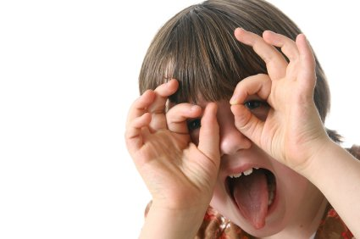
(notes about paying attention)
Attention span is often fine in activities child finds interesting & fun.
Q: Can child pay attention to not-so-interesting & fun stuff?
Good days/bad days.

Slide 14
ADHD: The Core Deficits
INATTENTION
IMPULSIVITY / HYPERACTIVITY

Slide 15

Hyperactivity-Impulsivity verbal & motor
Impulsive: trouble WAITING on what they want
Too much focus on NOW, not enough “future orientation.”
Excessive movement/verbal behavior
Fidgeting, squirming, running, climbing

Slide 16
Impulsivity
Behaving or speaking without adequately weighing risks & benefits
often associated with a higher risk of pathological gambling, substance abuse, poor interpersonal skills, car accidents, and incarceration.

Slide 17
EMOTIONAL DYSREGULATION in ADHD
Emotionally impulsive
Less able to control expression of emotions (negative & positive)
Low frustration tolerance, impatient

Slide 18
EMOTIONAL DYSREGULATION in ADHD
Quick anger/hostility
Emotional excitability, reactivity
Difficulties offsetting a negative emotion with a positive one
Impaired self-motivation

Slide 19
ADHD: The Core Deficits
Problems with ATTENTION
IMPULSIVITY / HYPERACTIVITY

Slide 20
treatment

Slide 21
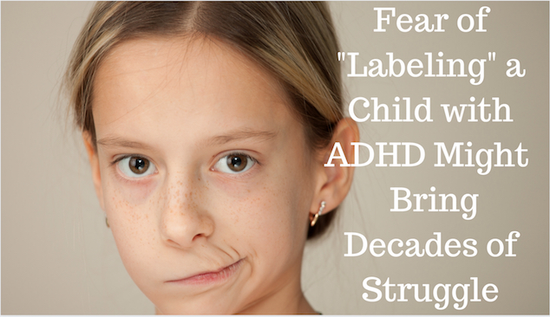

Slide 22
New systematic review of ADHD treatment
Peterson & Trampush et al. ”Treatments for ADHD in Children and Adolescents: A systematic review” PEDIATRICS vol 153, #4, April 2024.

Slide 23
April 2024 review of research (PEDIATRICS)
LARGE IMPROVEMENT | MODERATE IMPROVEMENT | LOW (but some) IMPROVEMENT
Amphetamines (the Adderall family) | Methlyphenidate (the Ritalin family) Non-stimulant meds (FDA-approved) | Psychosocial treatment Parent support Cognitive training Nutritional interventions
Available, lower cost Side effects (appetite loss chief among them) |  | Far less available, more costly, more time-consuming. No adverse effects (other than time/money)

Slide 24
Neurofeedback
2025 meta-analysis found no meaningful improvement in ADHD symptoms when ratings came from people unaware of treatment assignment.
Neurofeedback for Attention-Deficit/Hyperactivity Disorder: A Systematic Review and Meta-Analysis (JAMA Psychiatry, Vol 82, #2.
Samuel J. Westwood, PhD1; Pascal-M. Aggensteiner, PhD2; Anna Kaiser, PhD2 et al

Slide 25
Surprisingly…
Research has not consistently shown additional improvement in core ADHD symptoms from combined treatment. But behavioral treatment can still help with parenting, behavior, and daily functioning.

Slide 26
Peterson, TRAMPISH et. al. “Treatments for ADHD in Children and Adolescents: A Systematic Review” PEDIATRICS. 2024: 153(4)
“Clinical guidelines currently advise treatment of youth >6 years of age with FDA-approved medications, which the findings of this review support. Furthermore, FDA-approved medications have been shown to significantly improve broadband measures…(and) have been shown to improve disruptive behaviors, suggesting their clinical benefits extent beyond improving only ADHD symptoms.”

Slide 27
ADHD treatments with best evidence*
Core symptoms (inattention, impulsivity, hyperactivity) (Note: Emotional dysregulation?) | Stimulant meds (1st line) Behavior therapies 2nd line meds (Atomoxetine, extended-release alpha-2 agonists) IEP / 504
Oppositional/defiant/conduct disorder | Parent behavior management School behavior management
Depression/anxiety/PTSD/other comorbidities | Appropriate treatments for those (CBT, medication, etc.)
Family conflict, family dysfunction | Family therapy
Underachievement, learning/language d/o | IEP/504
*Adapted from Wolrach, M. & Hagan, J. ADHD: What every parent needs to know (3rd Edition). 2019, American Academy of Pediatrics.

Slide 28

What helps parents (and patients) feel better about stimulant medications?
Stimulants do not accumulate in the body. “In and out”
Meds don’t “change personality.”
Your child is not a zombie.

Slide 29



Slide 30
What helps parents (and patients) feel better about stimulant medications?
Stimulants do not accumulate in the body. “In and out”
Meds don’t “change personality.”
Your child is not a zombie.
Stimulant treatment does not increase risk of substance abuse and might mitigate it.

Slide 31
What helps parents (and patients) feel better about stimulant medications?
Weight/growth issues may be an issue, but are almost always manageable
A trial of meds is not a commitment to long-term use
Side effects are not commonly serious / long-lasting
Discussion of risk-benefits. (The meds may be “bad” but untreated ADHD is worse.)

Slide 32
What helps parents (and patients) feel better about stimulant medications?
Goal is better functioning while your child remains themselves.
Emotional flattening, unusual irritability, or seeming unlike themselves warrants a medication review.
Monitor appetite, sleep, height/weight, blood pressure, pulse.

Slide 33


Medication
Parent & Patient Education
Parenting Support
Educational Modifications/Accommodations
Exercise/Outdoor Time

Slide 34
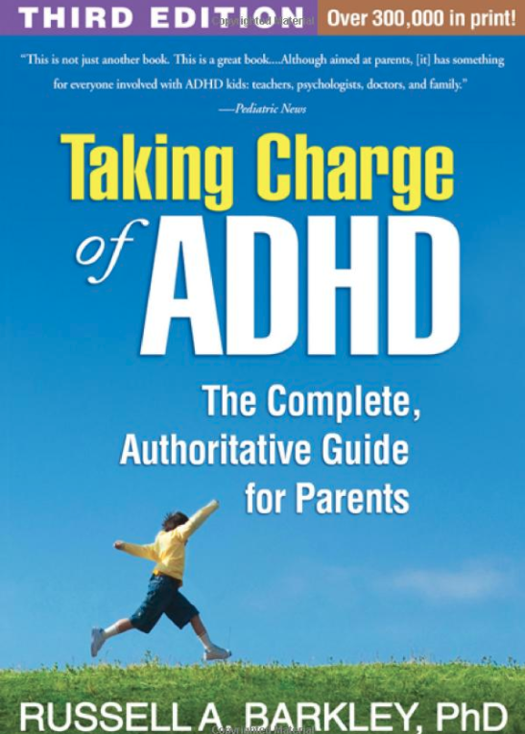

Slide 35


Slide 36

Hi. I have ADHD. I get up every morning and decide to make my parents’ lives miserable.

Slide 37

Mental Health Care?
Everyone with ADHD should have regular follow-up with a clinician knowledgeable about ADHD, including checks for co-occurring problems. Even if they appear to be doing well.

Slide 38
Common co-occurring disorders
Perhaps as many as 70% of people with ADHD will qualify for another diagnosis at some point.

Slide 39
ADHD & Girls: New Study (UCLA, PEDIATRICS, Oct 2016)
2000 girls between 8-13
Girls with attention deficit hyperactivity disorder are at higher risk than girls without ADHD for multiple mental disorders that often lead to cascading problems such as abusive relationships, teenage pregnancies, poor grades and drug abuse.
Co-occurring disorders | ADHD GIRLS | Non-ADHD GIRLS
Anxiety Disorder | 38% | 14%
Depression | 10% | 3%
Oppositional/ Defiant | 42% | 5%
Conduct Disorder | 13% | <1%

Slide 40
Adult Complications of untreated ADHD
School underachievement/failure
Depression, self-harm, suicide
Poor relationships, including marriages (divorces)
Substance abuse
Job problems

Slide 41
Risks of untreated ADHD in adults
Low self-esteem, depression, and anxiety
Chronic stress due to these issues can also lead to other conditions.
Difficulty in relationships
Job instability.
Negative parent-child interactions
Drug and alcohol misuse
Increased mortality rate
A myriad of health problems which, on the surface, would seem to not have anything to do with ADHD

Slide 42
Adult Complications of untreated ADHD
Financial problems (Lower SES, underemployment & financial mismanagement)
Incarcerations
Unplanned pregnancies
ACCIDENTS (driving, head injury)

Slide 43

ADHD is NOT merely a person who has trouble paying attention, who may or may not be hyperactive.

Slide 45
No greater blessing in the life of a child with ADHD than adults who understand ADHD.

Slide 46
Slides: dalewisely.com/files

Slide 47







